Slide 1



Downtown Yachats
Parking Planning
Public Workshop | July 18, 2022
PROJECT OVERVIEW, GOALS, AND WORK TO DATE

Slide 2
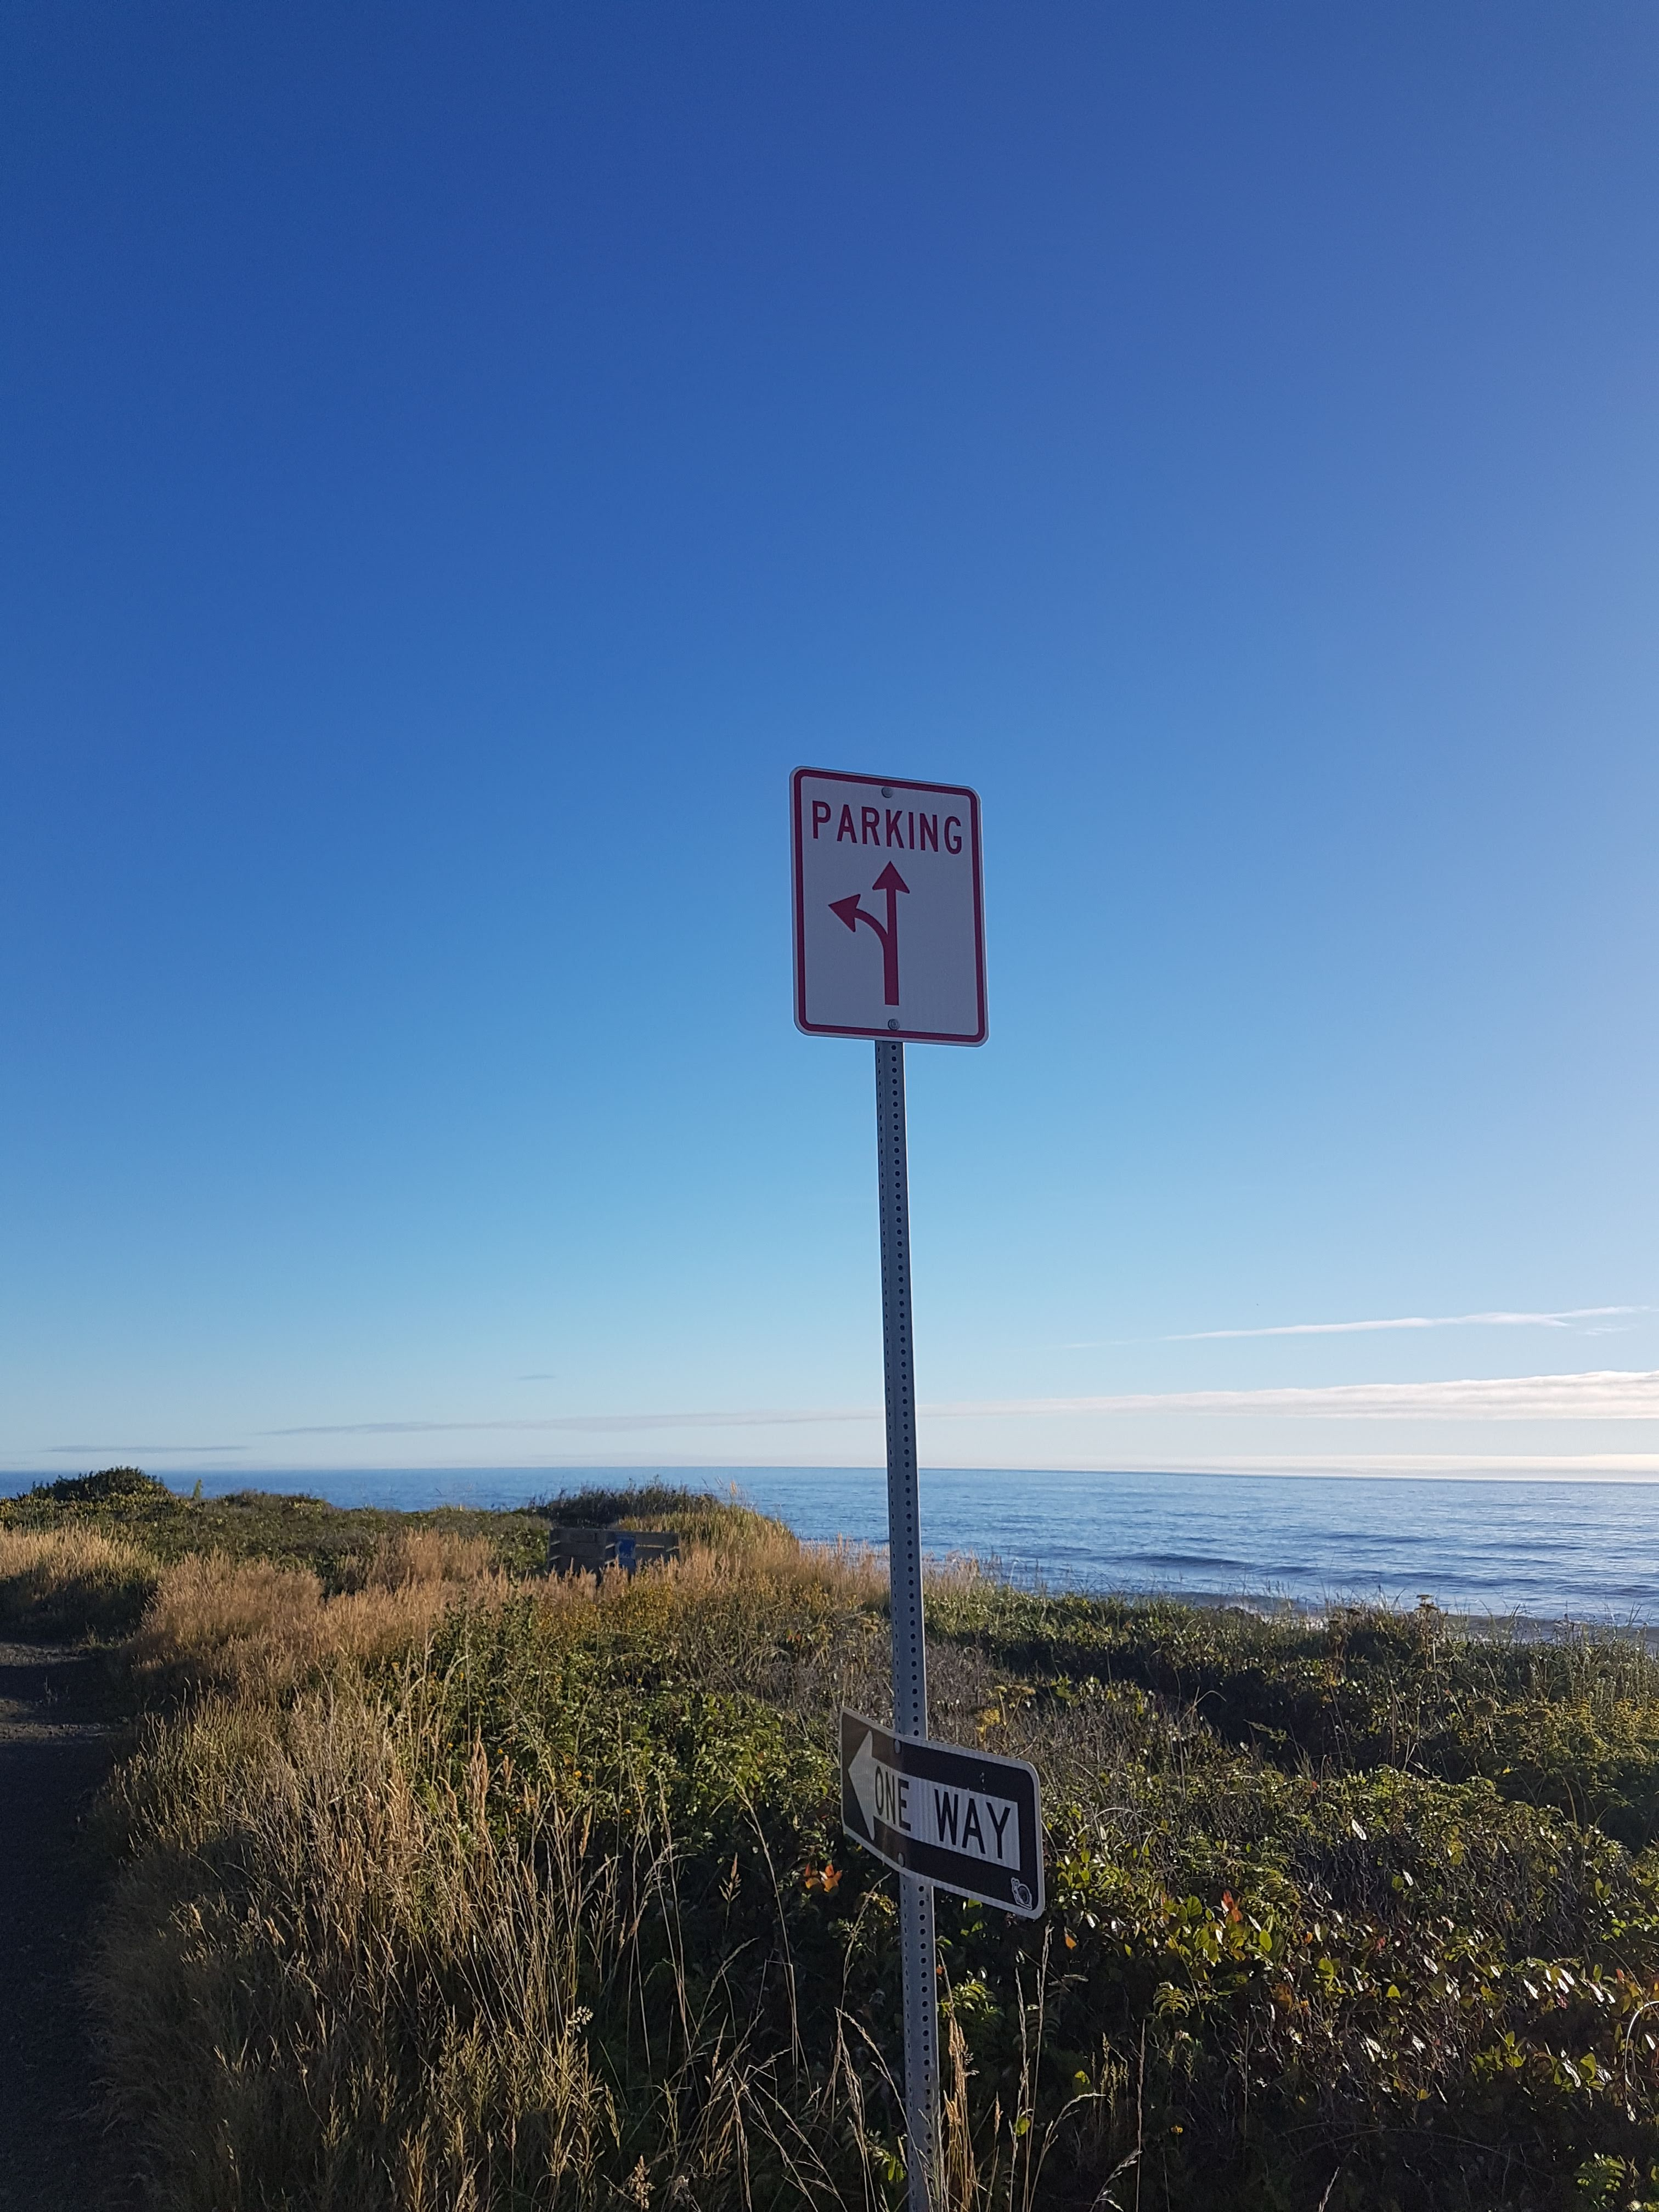
Project Overview: Goals, Area, Context

Slide 3
Workshop Goals and Agenda
Discuss guidance, context, and work done to date
Discuss parking management strategies and tools, and look at examples from other Coastal cities
Discuss problems identified (so far) with parking downtown
MOST IMPORTANTLY: Get your input!
  What are the key issues you are experiencing?
  What should the City do about them?

Slide 4
Project Goals
Identify key parking issues experienced by residents, employees, and visitors to Yachats.
Discuss and identify potential solutions with robust public input
Prepare plan of action for the City of Yachats to manage parking now and into the future

Slide 5
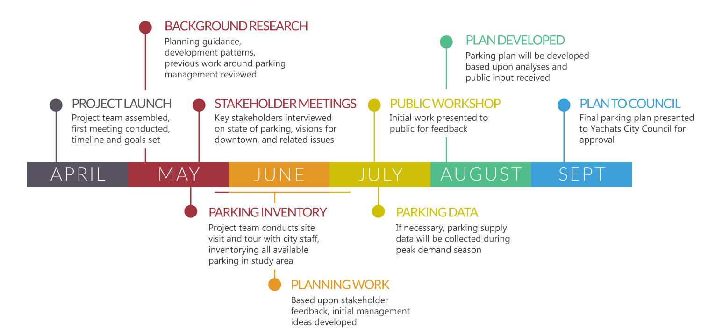
Project Timeline

Slide 6
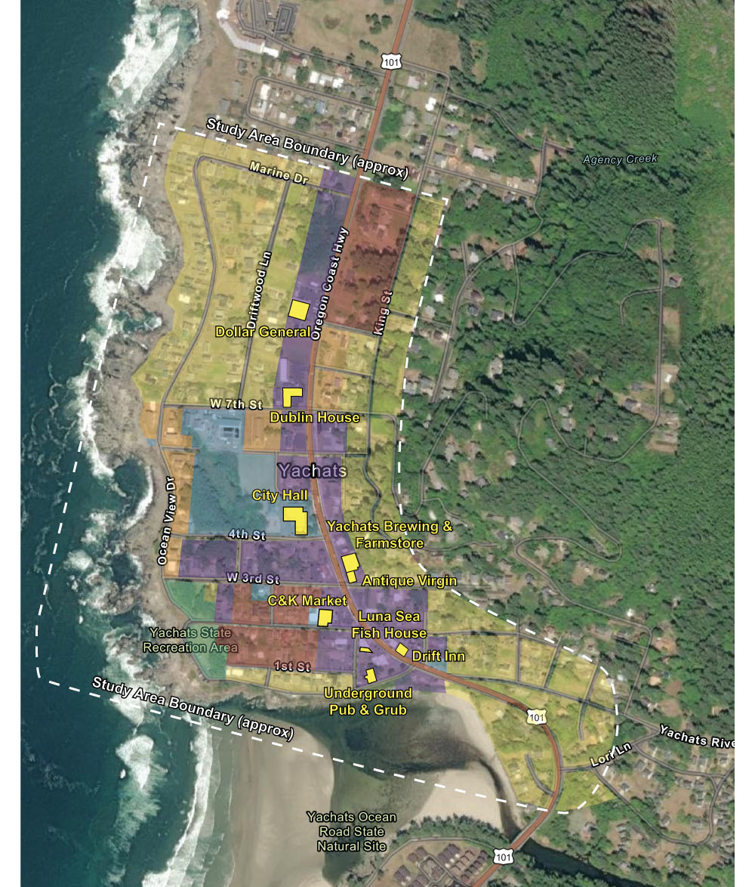
Plan Area
Zoning
R-1 Single-family res
R-2 Single-fam / duplex
R-3 SFD/ duplex / multifam
C-1 Commercial
PF Public Facilities
S-P State Parks

Slide 7
Yachats Key Demographic Info
Current population: ~1,000
  Nearly 50% growth since 2016. Population was ~700 for many years prior
  Often feels much bigger w/visitors…Guesses as to how many??
Median age: ~64 – 65 years
  Oregon median age: ~40 years
Median household income: ~$51K
  Oregon median household income: ~$66K
Retirees!

Slide 8
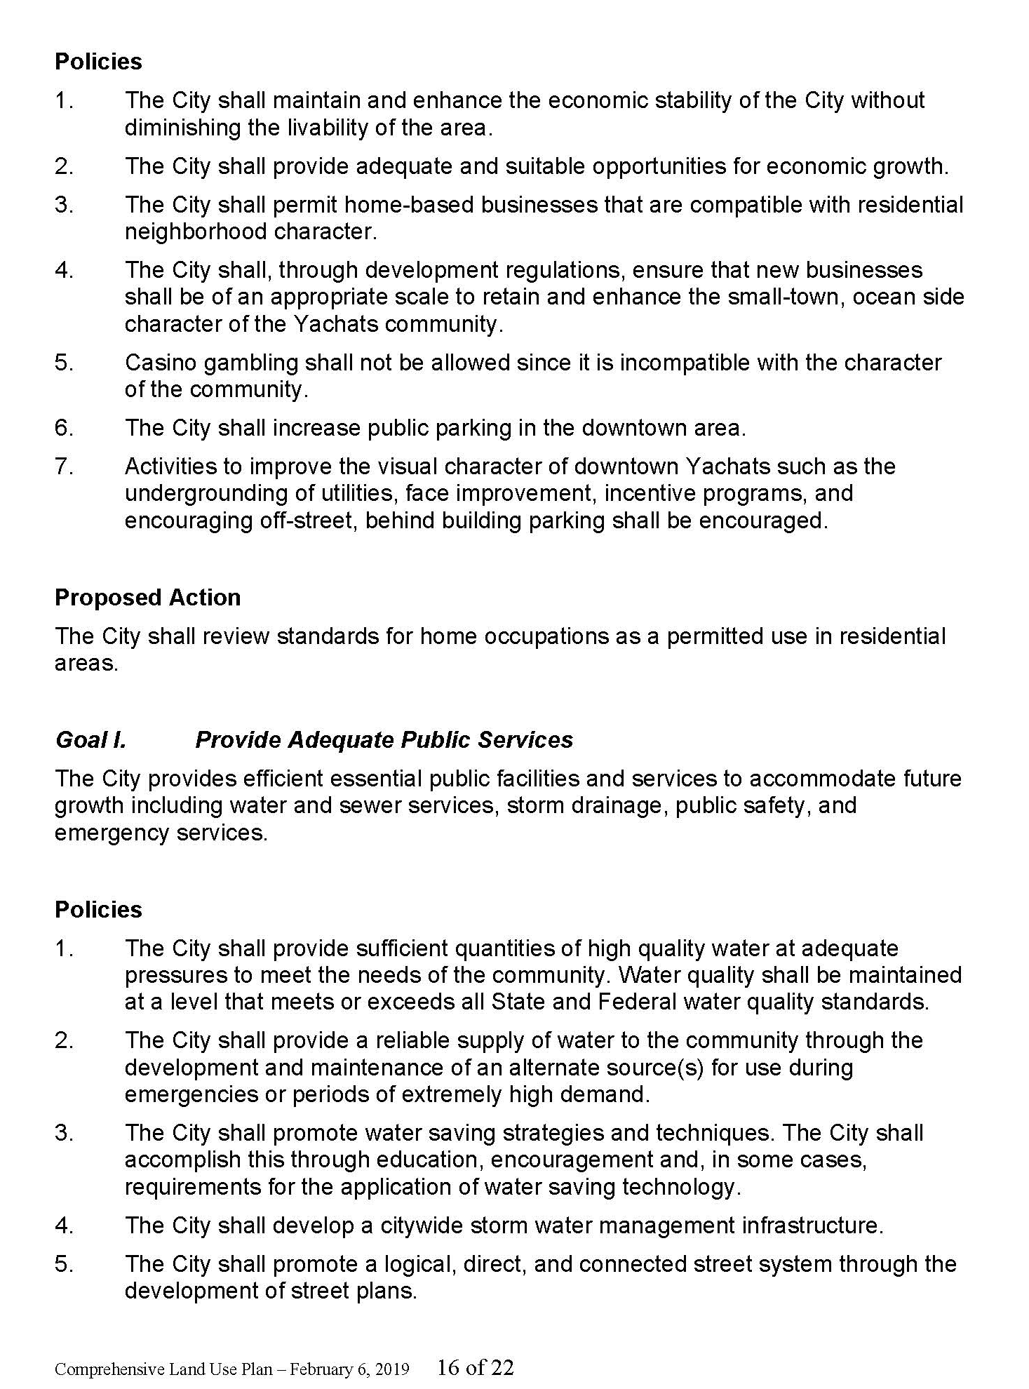
Planning Guidance
Most important document serving as an “instruction manual” in Yachats (as with most cities) is 2019 Comprehensive Plan
Comp Plan includes guidance within at least three goals
  G. Control of Urban Growth and Form
  H. Provide for economic growth
  I. Provide for adequate public services
Additional guidance within Parks & Open Space Master Plan

Slide 9
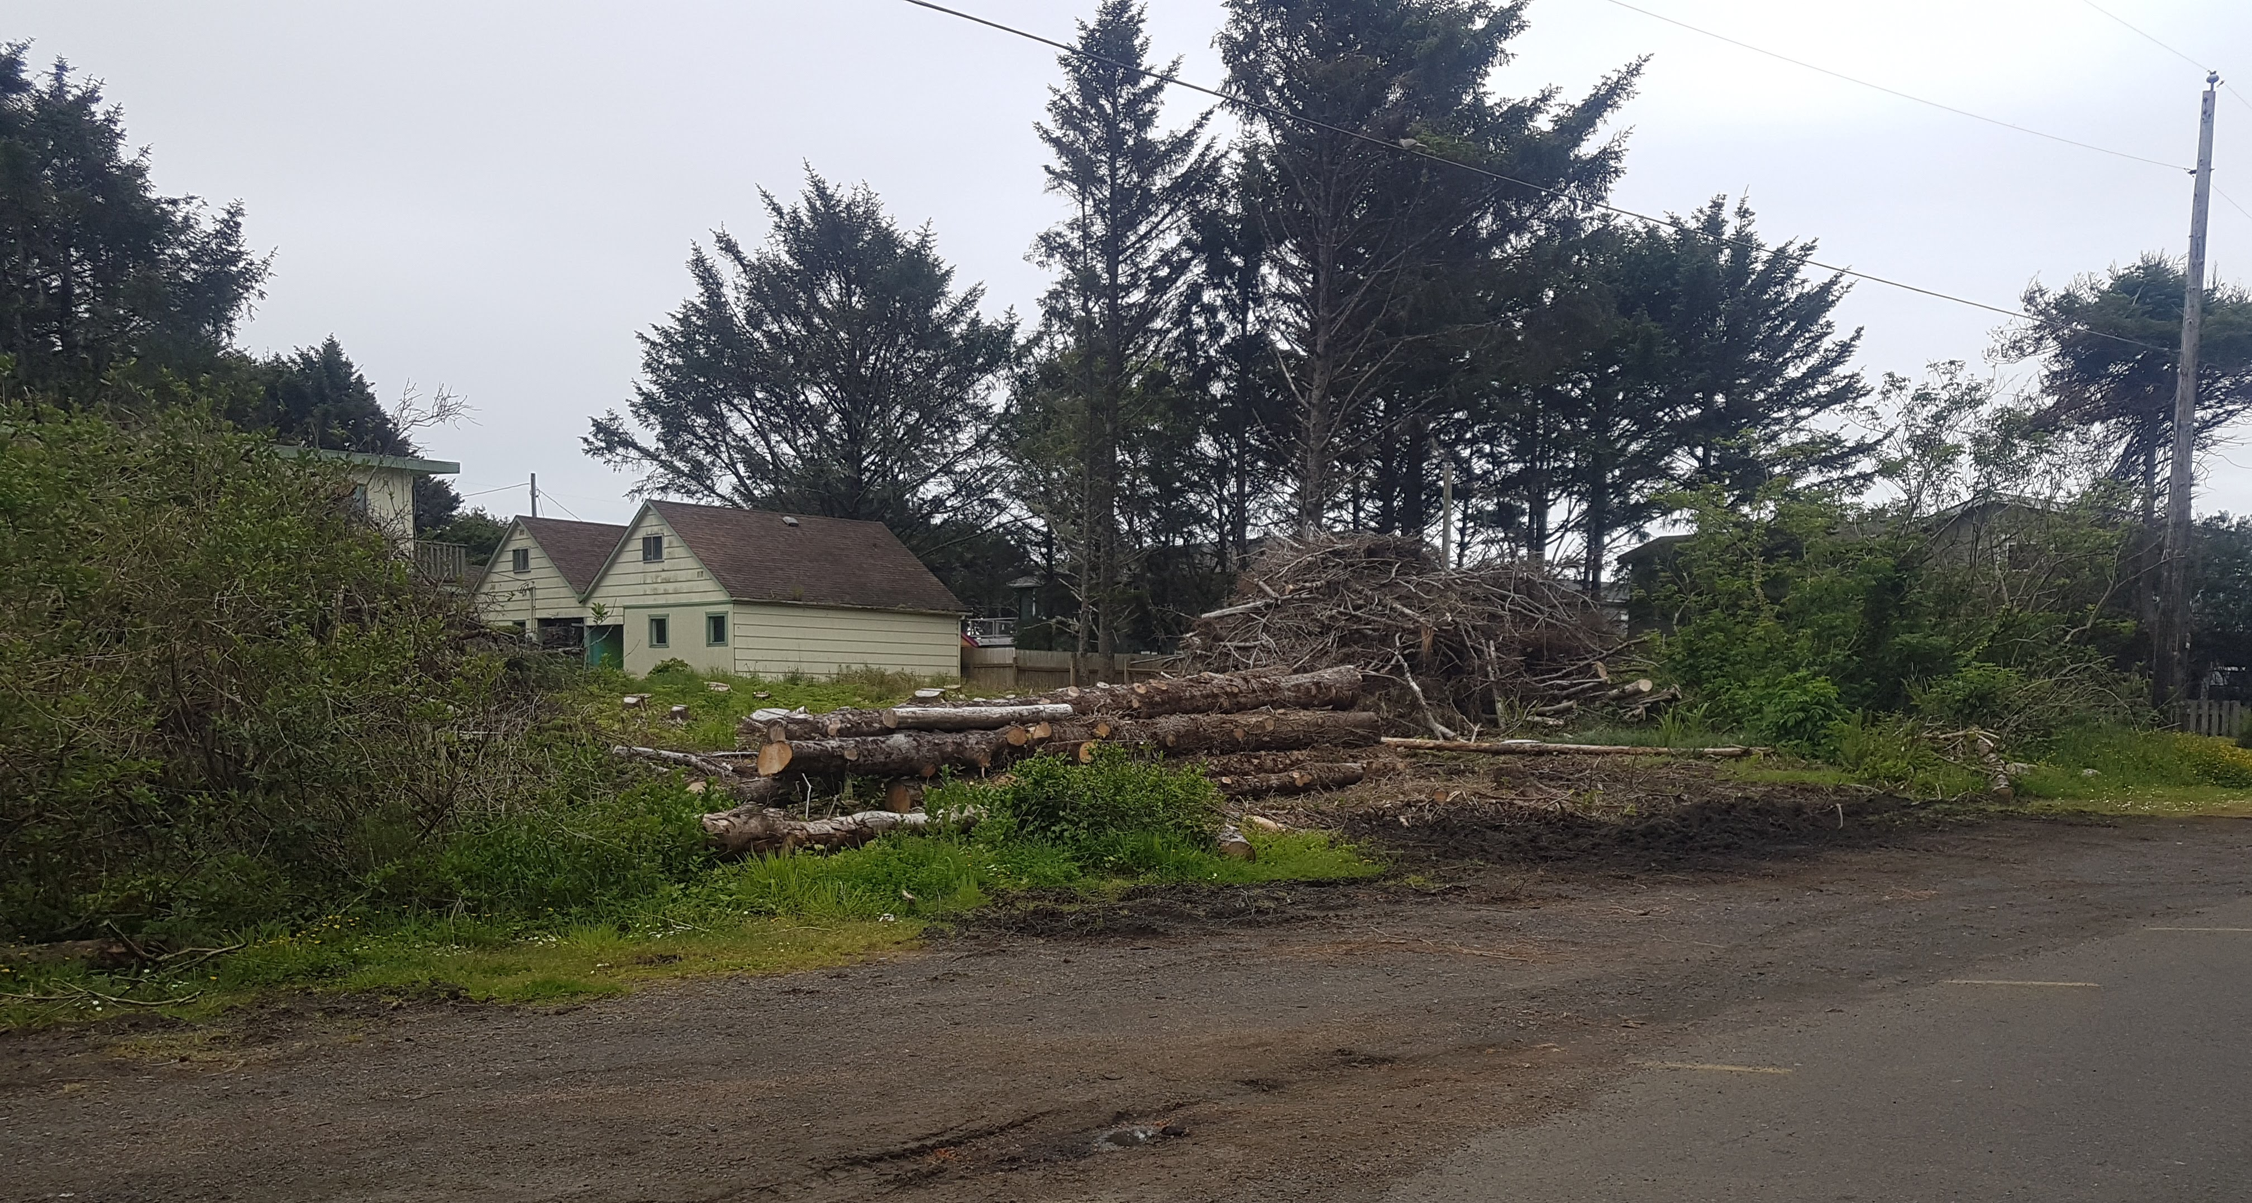
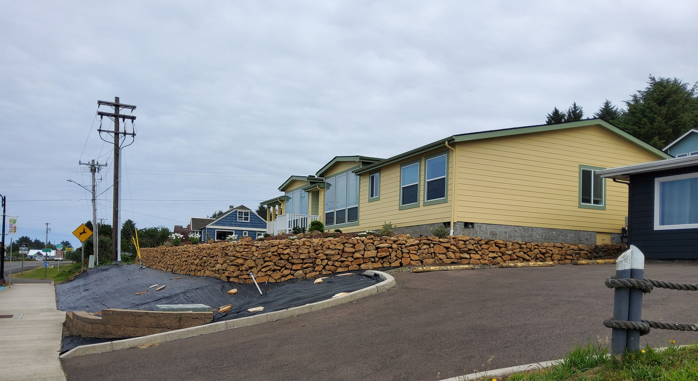
Recent & Future Development
Most key commercial structures have been in place for 10+ years. Few developable lots remain within downtown area
Recent residential infill along 7th north of Yatel
Recently acquired developable lot at 4th/Pontiac
Some tenant spaces within existing buildings are vacant
  Ex. Space next to Yachats Cannabis

Slide 10
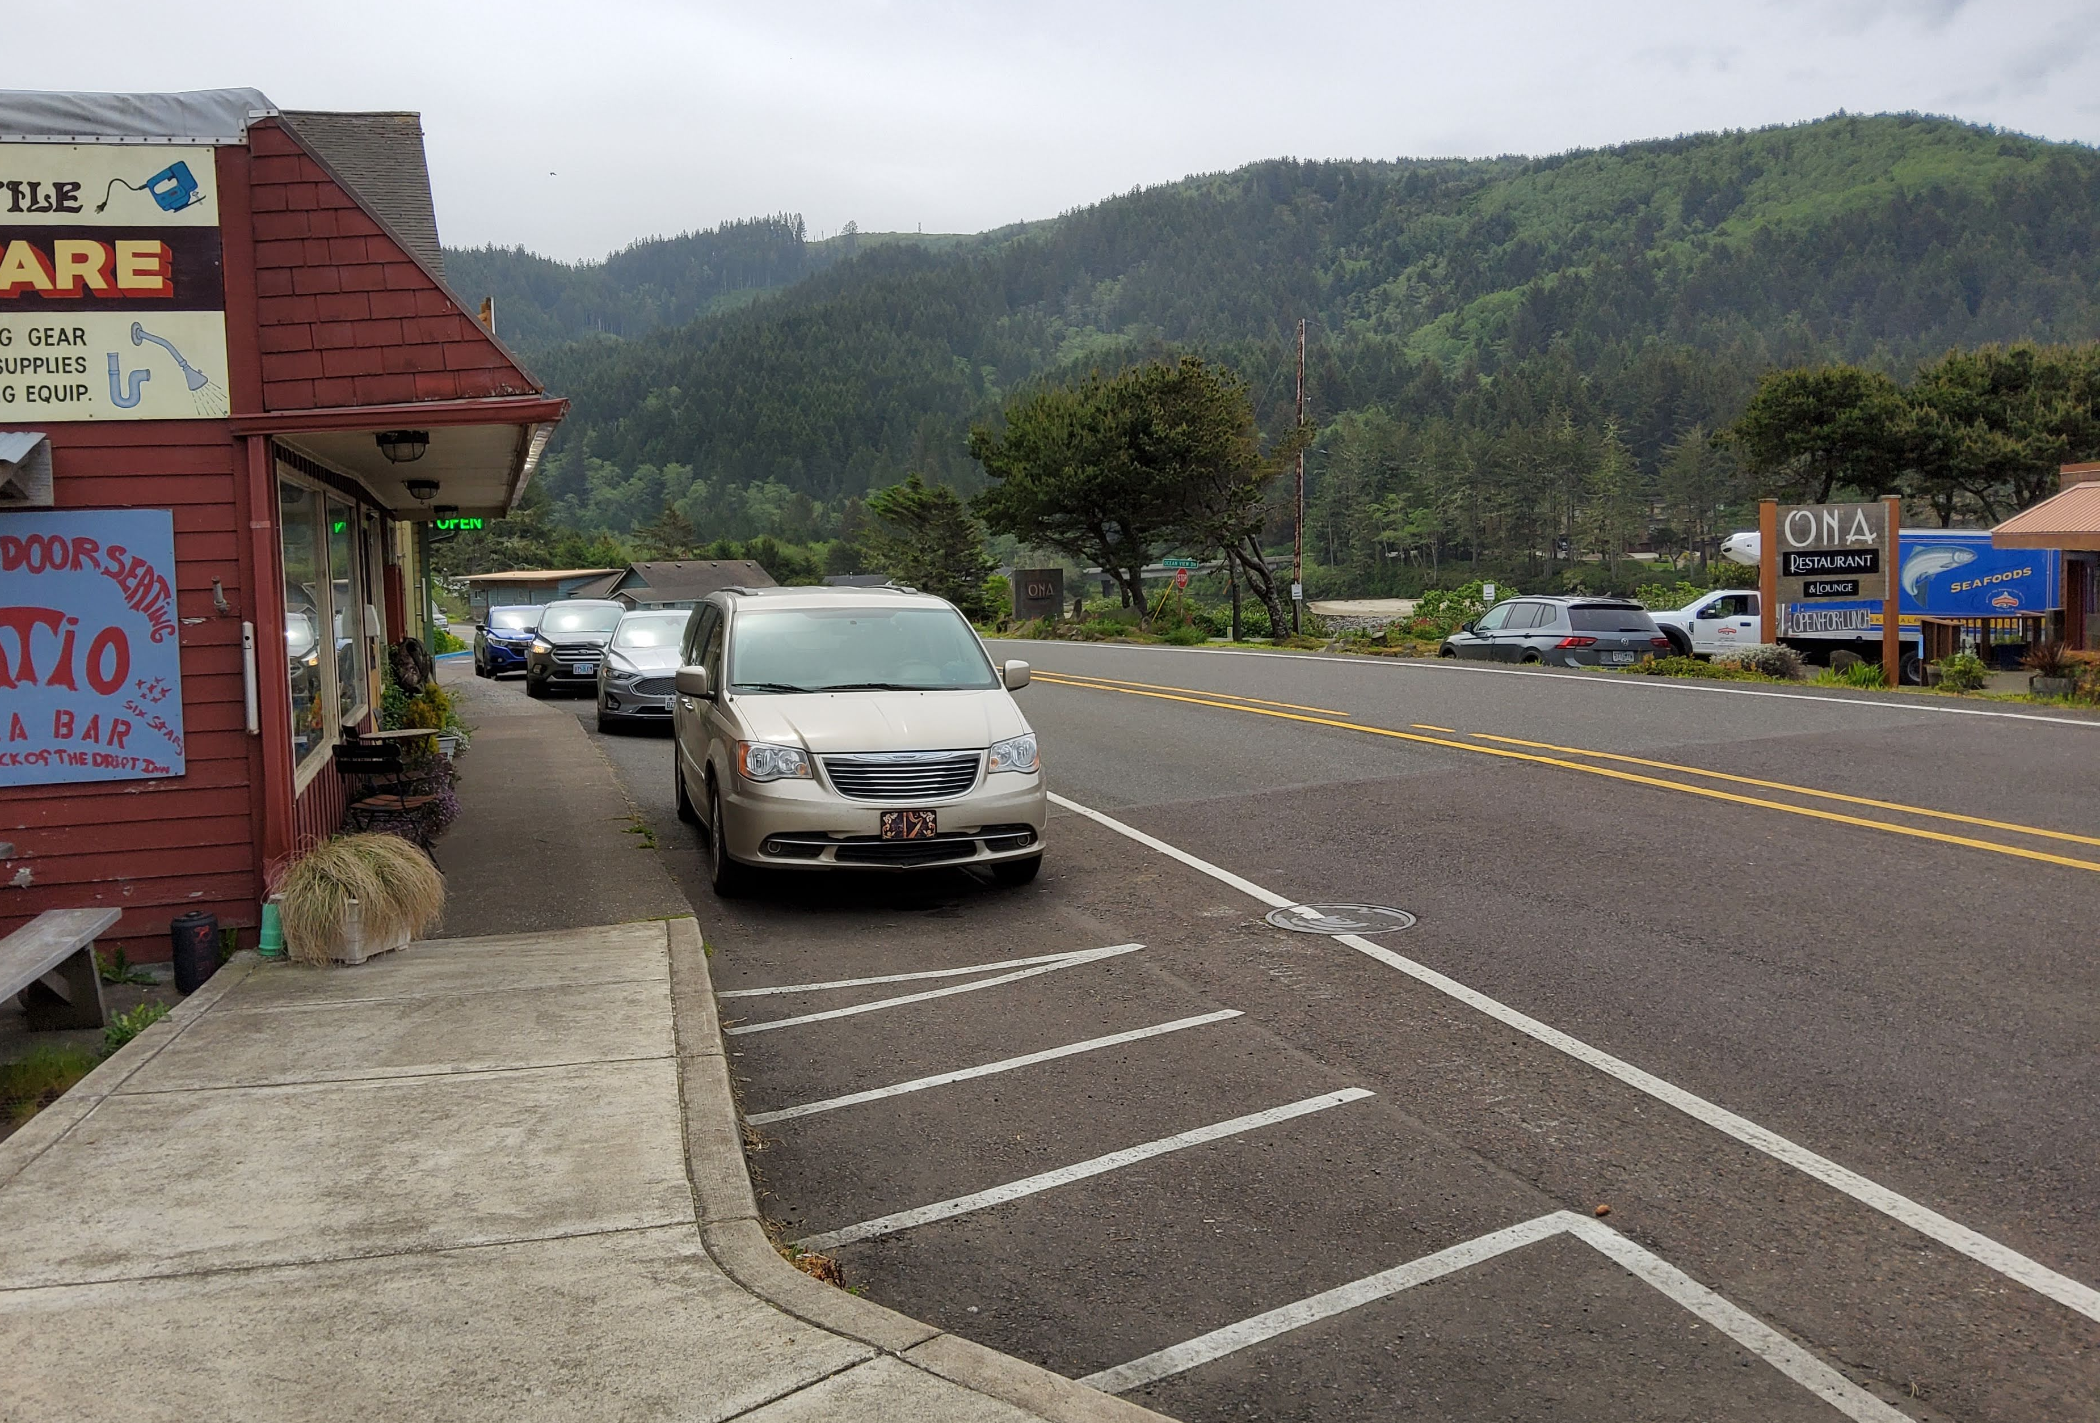
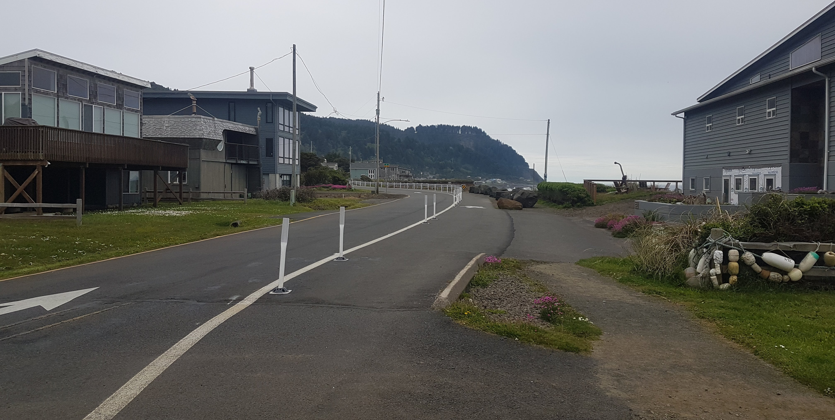
Transportation Infrastructure
Nearly all traffic arrives and departs via Highway 101
Recent Highway 101 project added sidewalks and improved walkability, but reduced available parking and ROW available for loading, etc.
Coupled with recent conversion of a lane on Ocean View from driving to walking, circulation is more difficult

Slide 11
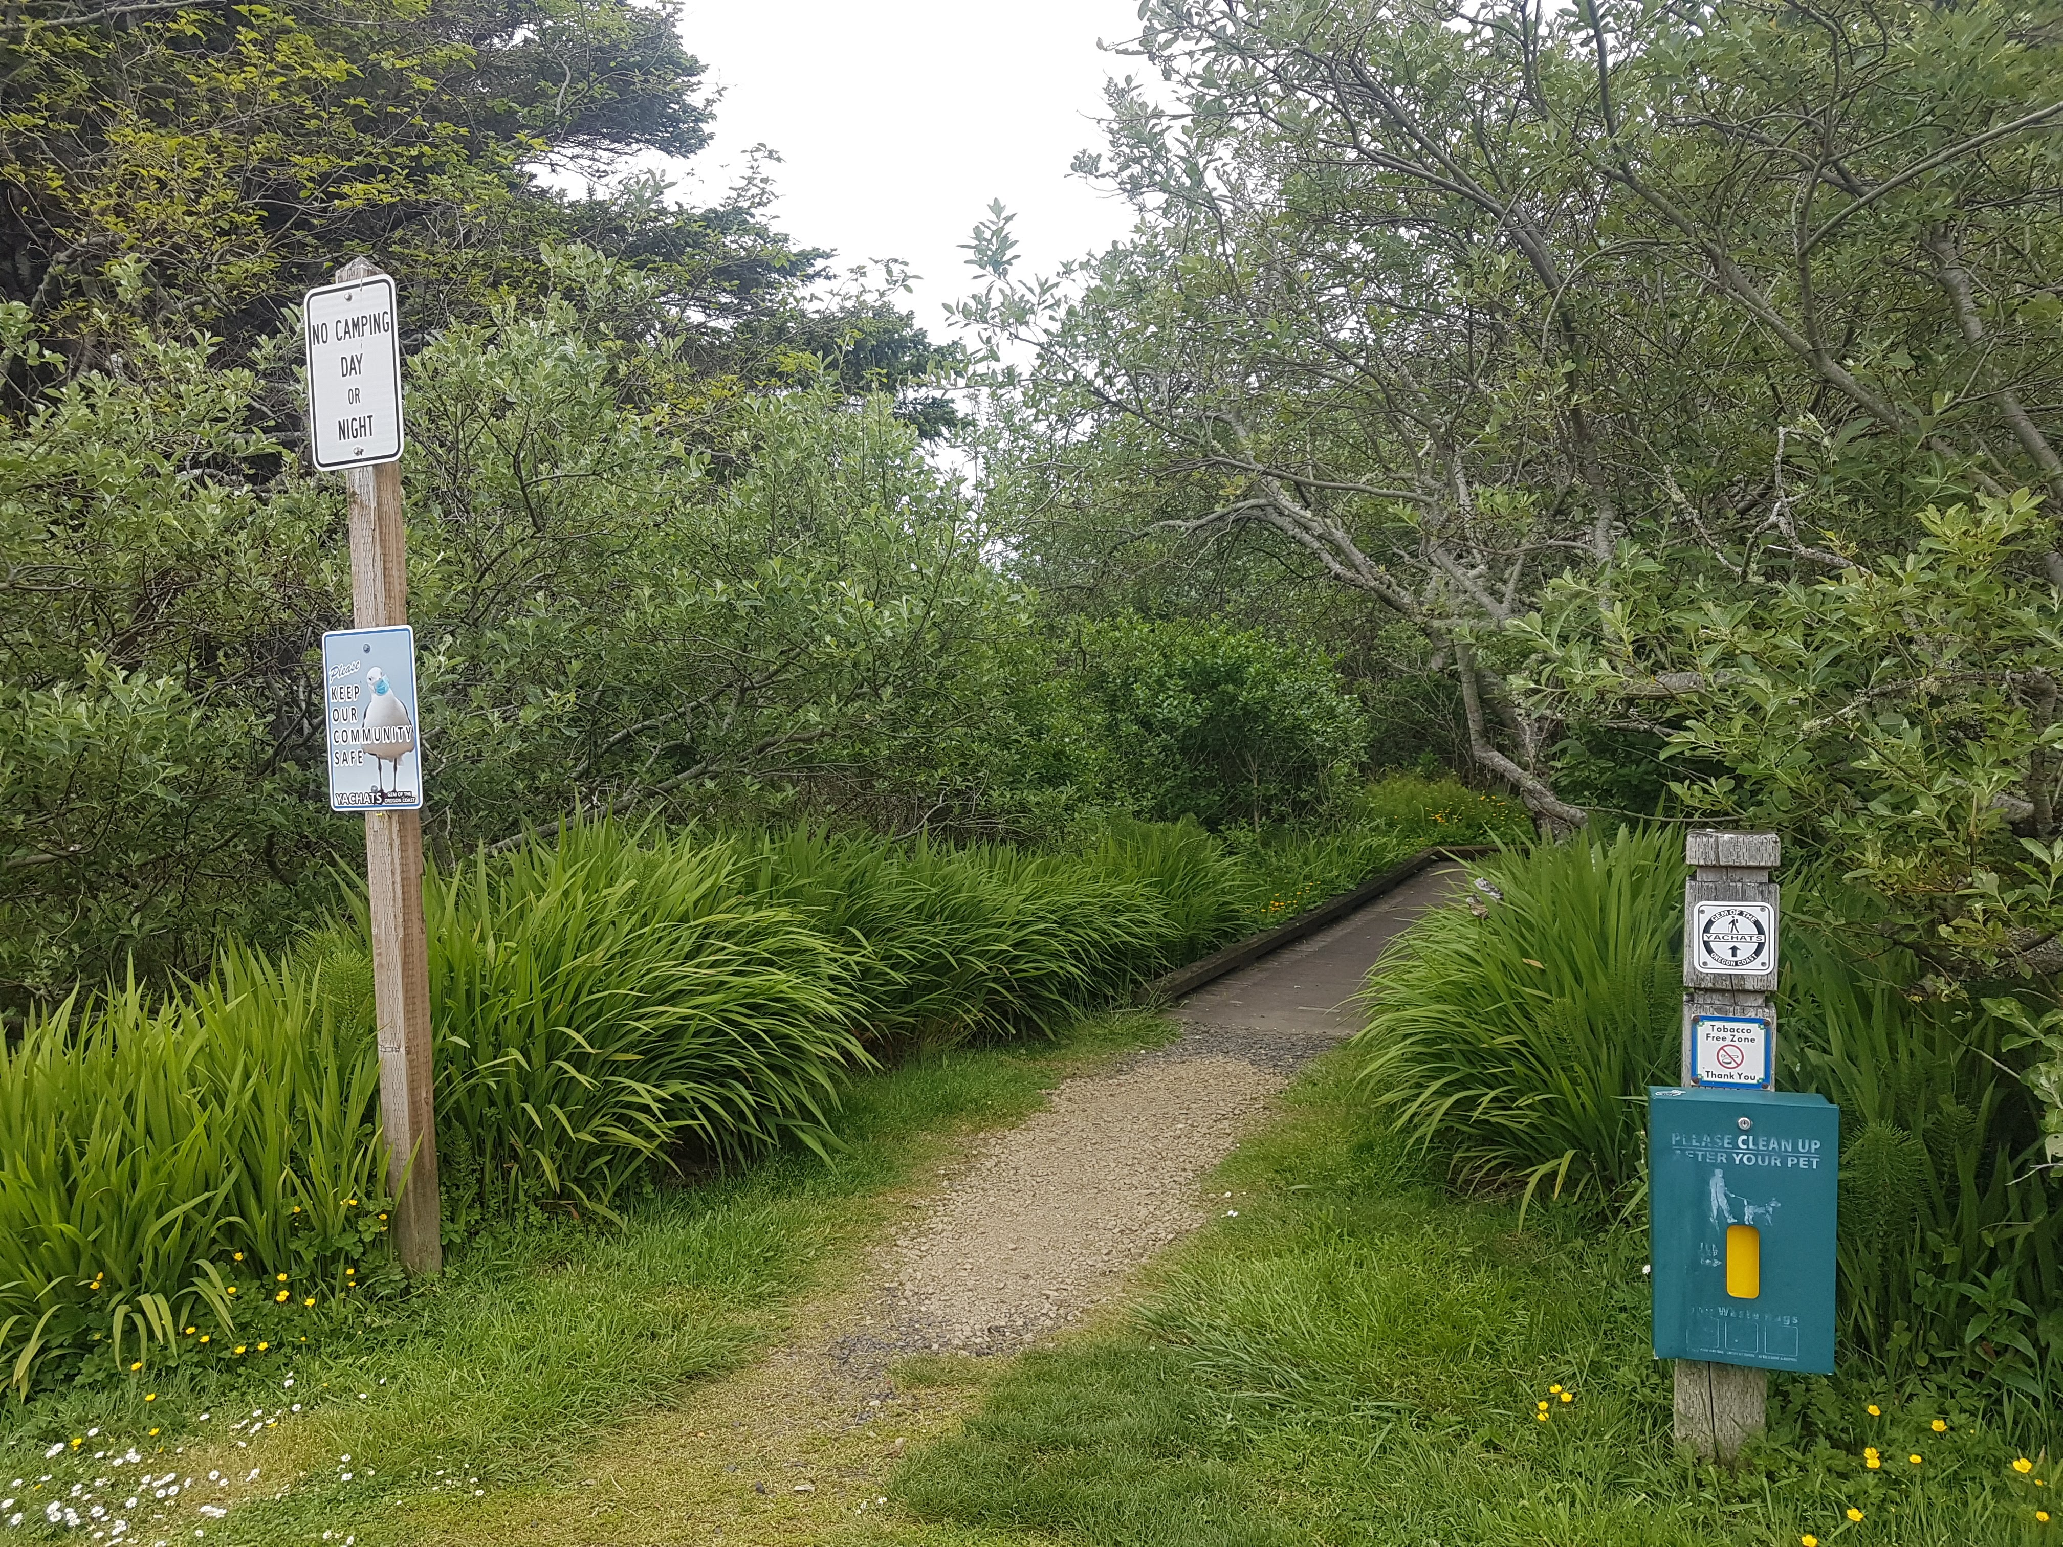
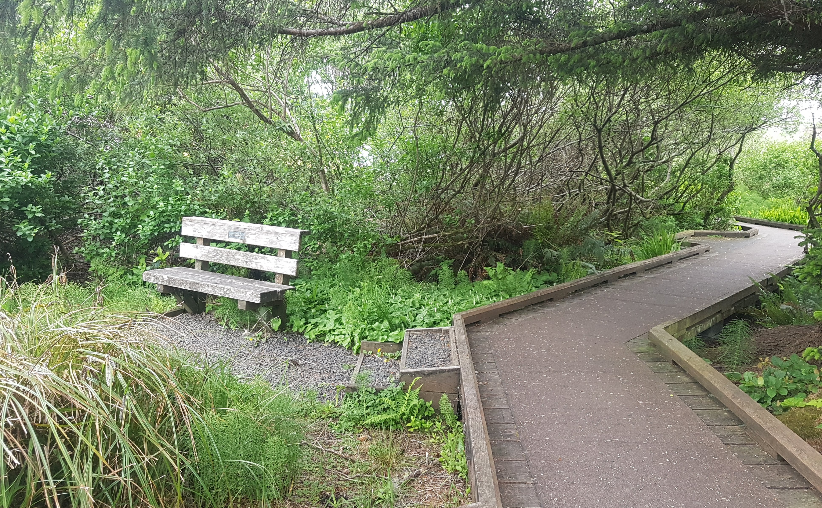
Walking Infrastructure
BUT!
While improvements to Highway 101 and Ocean View Drive reduced parking availability and circulation for cars, walking environment was drastically improved
These improvements + integration of hiking trails present excellent walkability and can be used to “activate” parking further from downtown

Slide 12
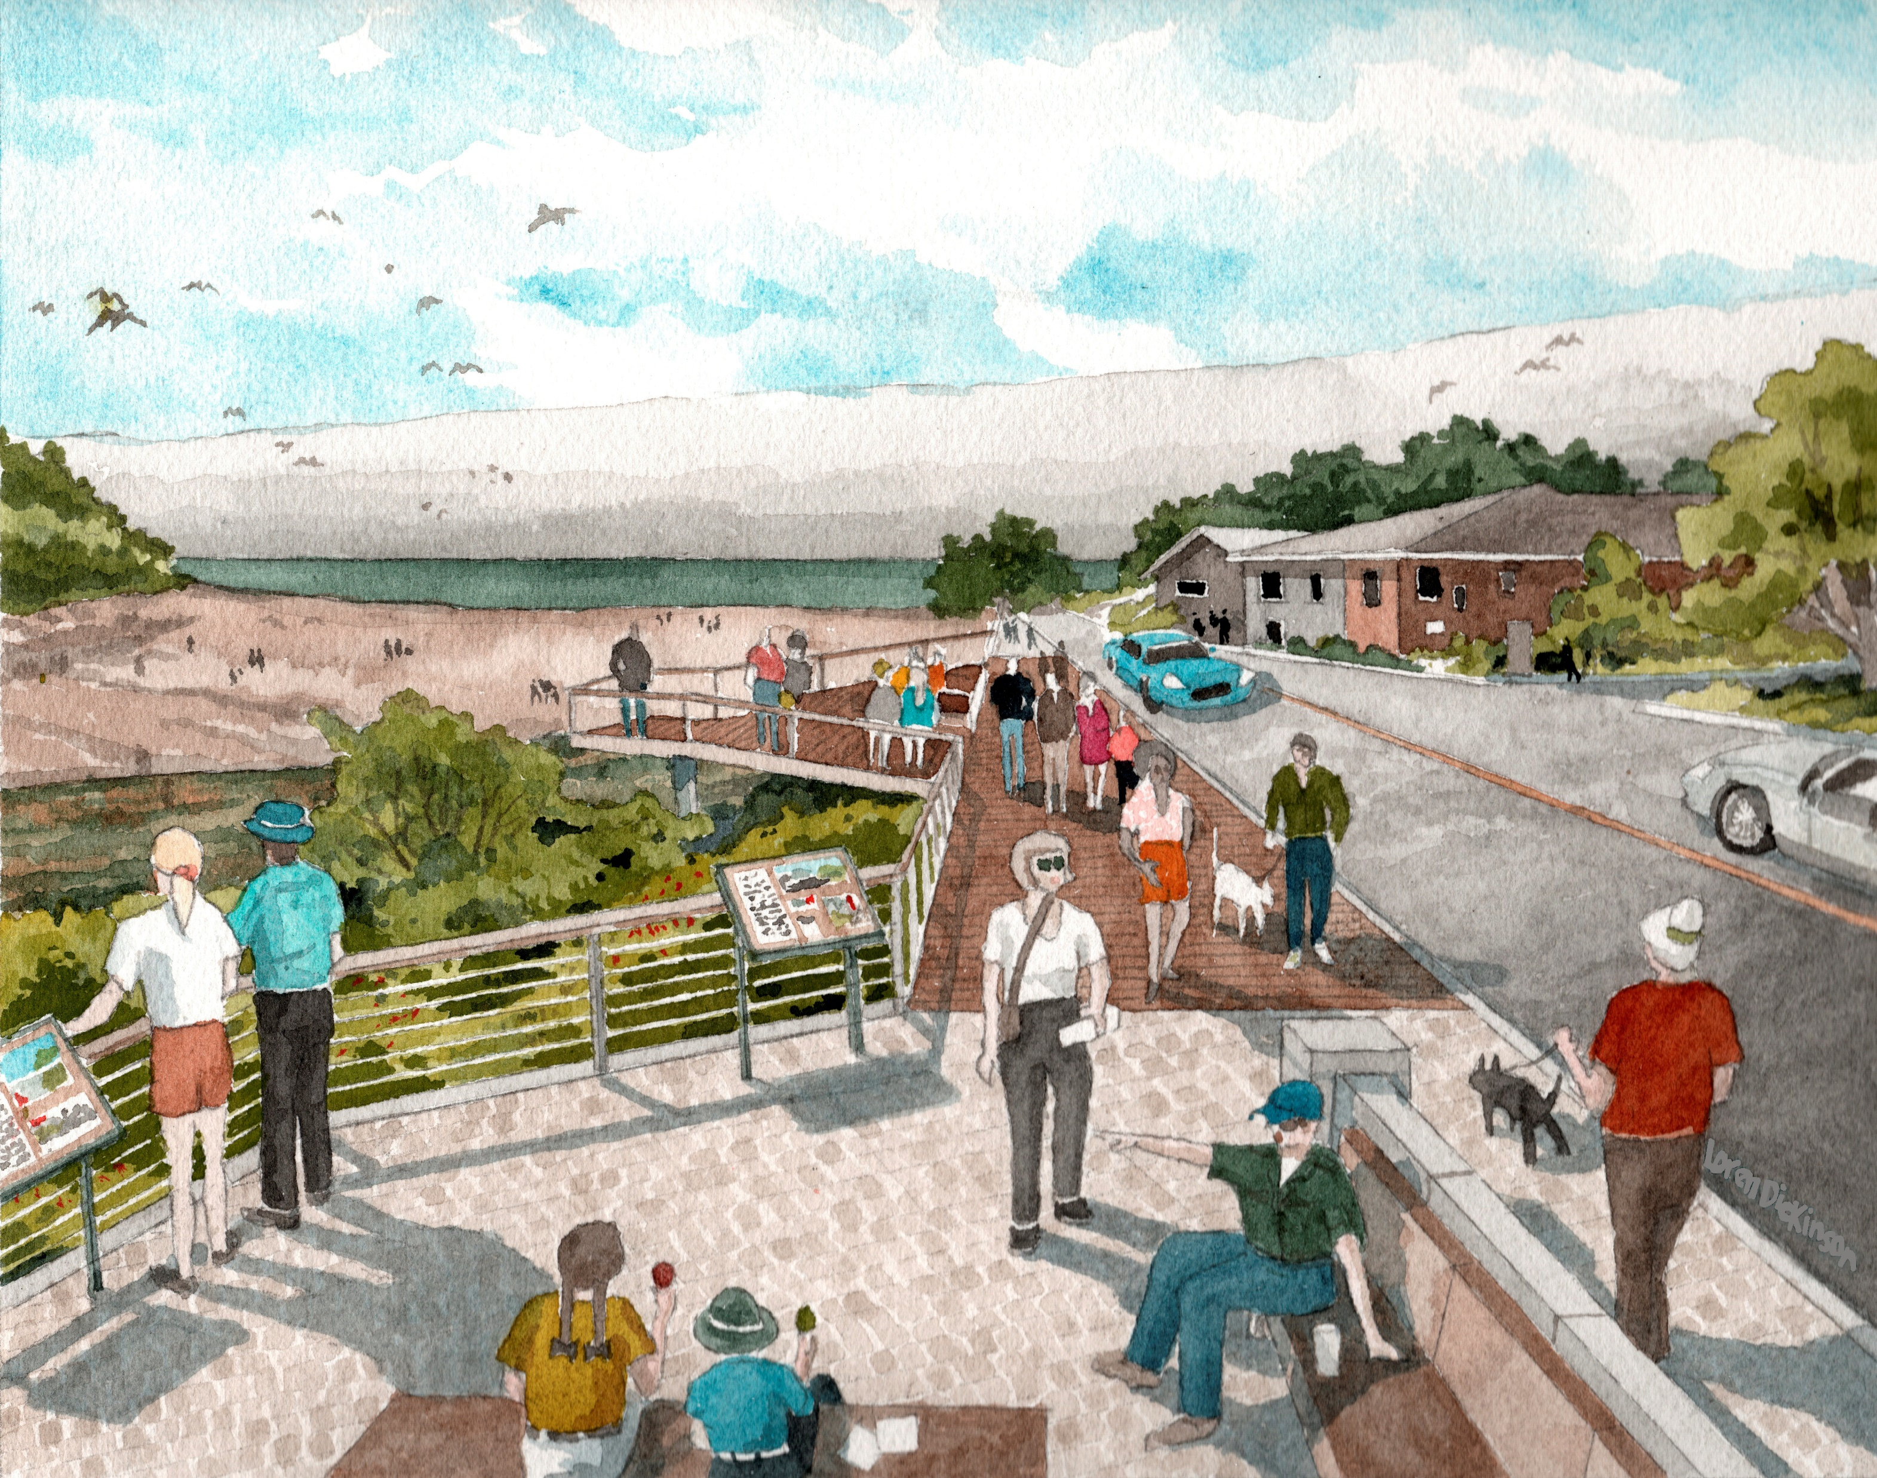
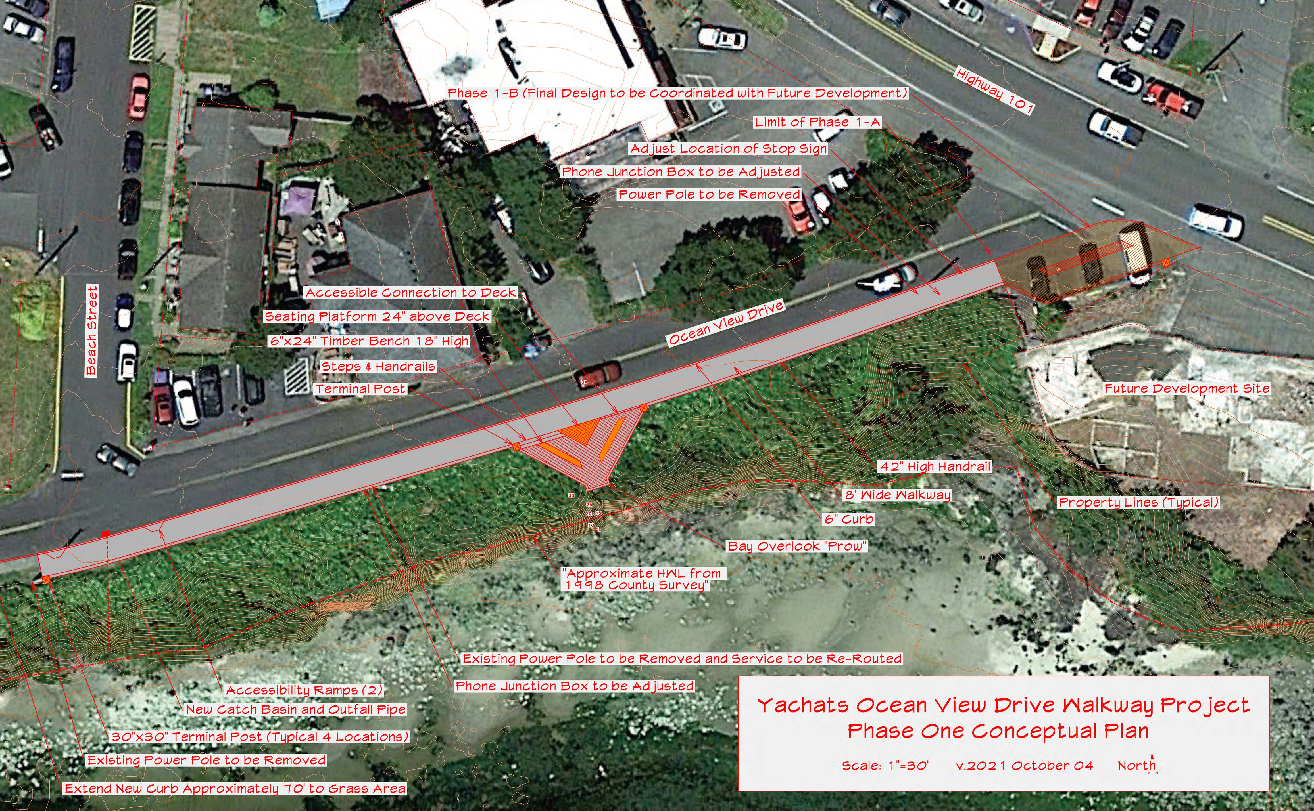
Proposed Boardwalk on Ocean View

Slide 13
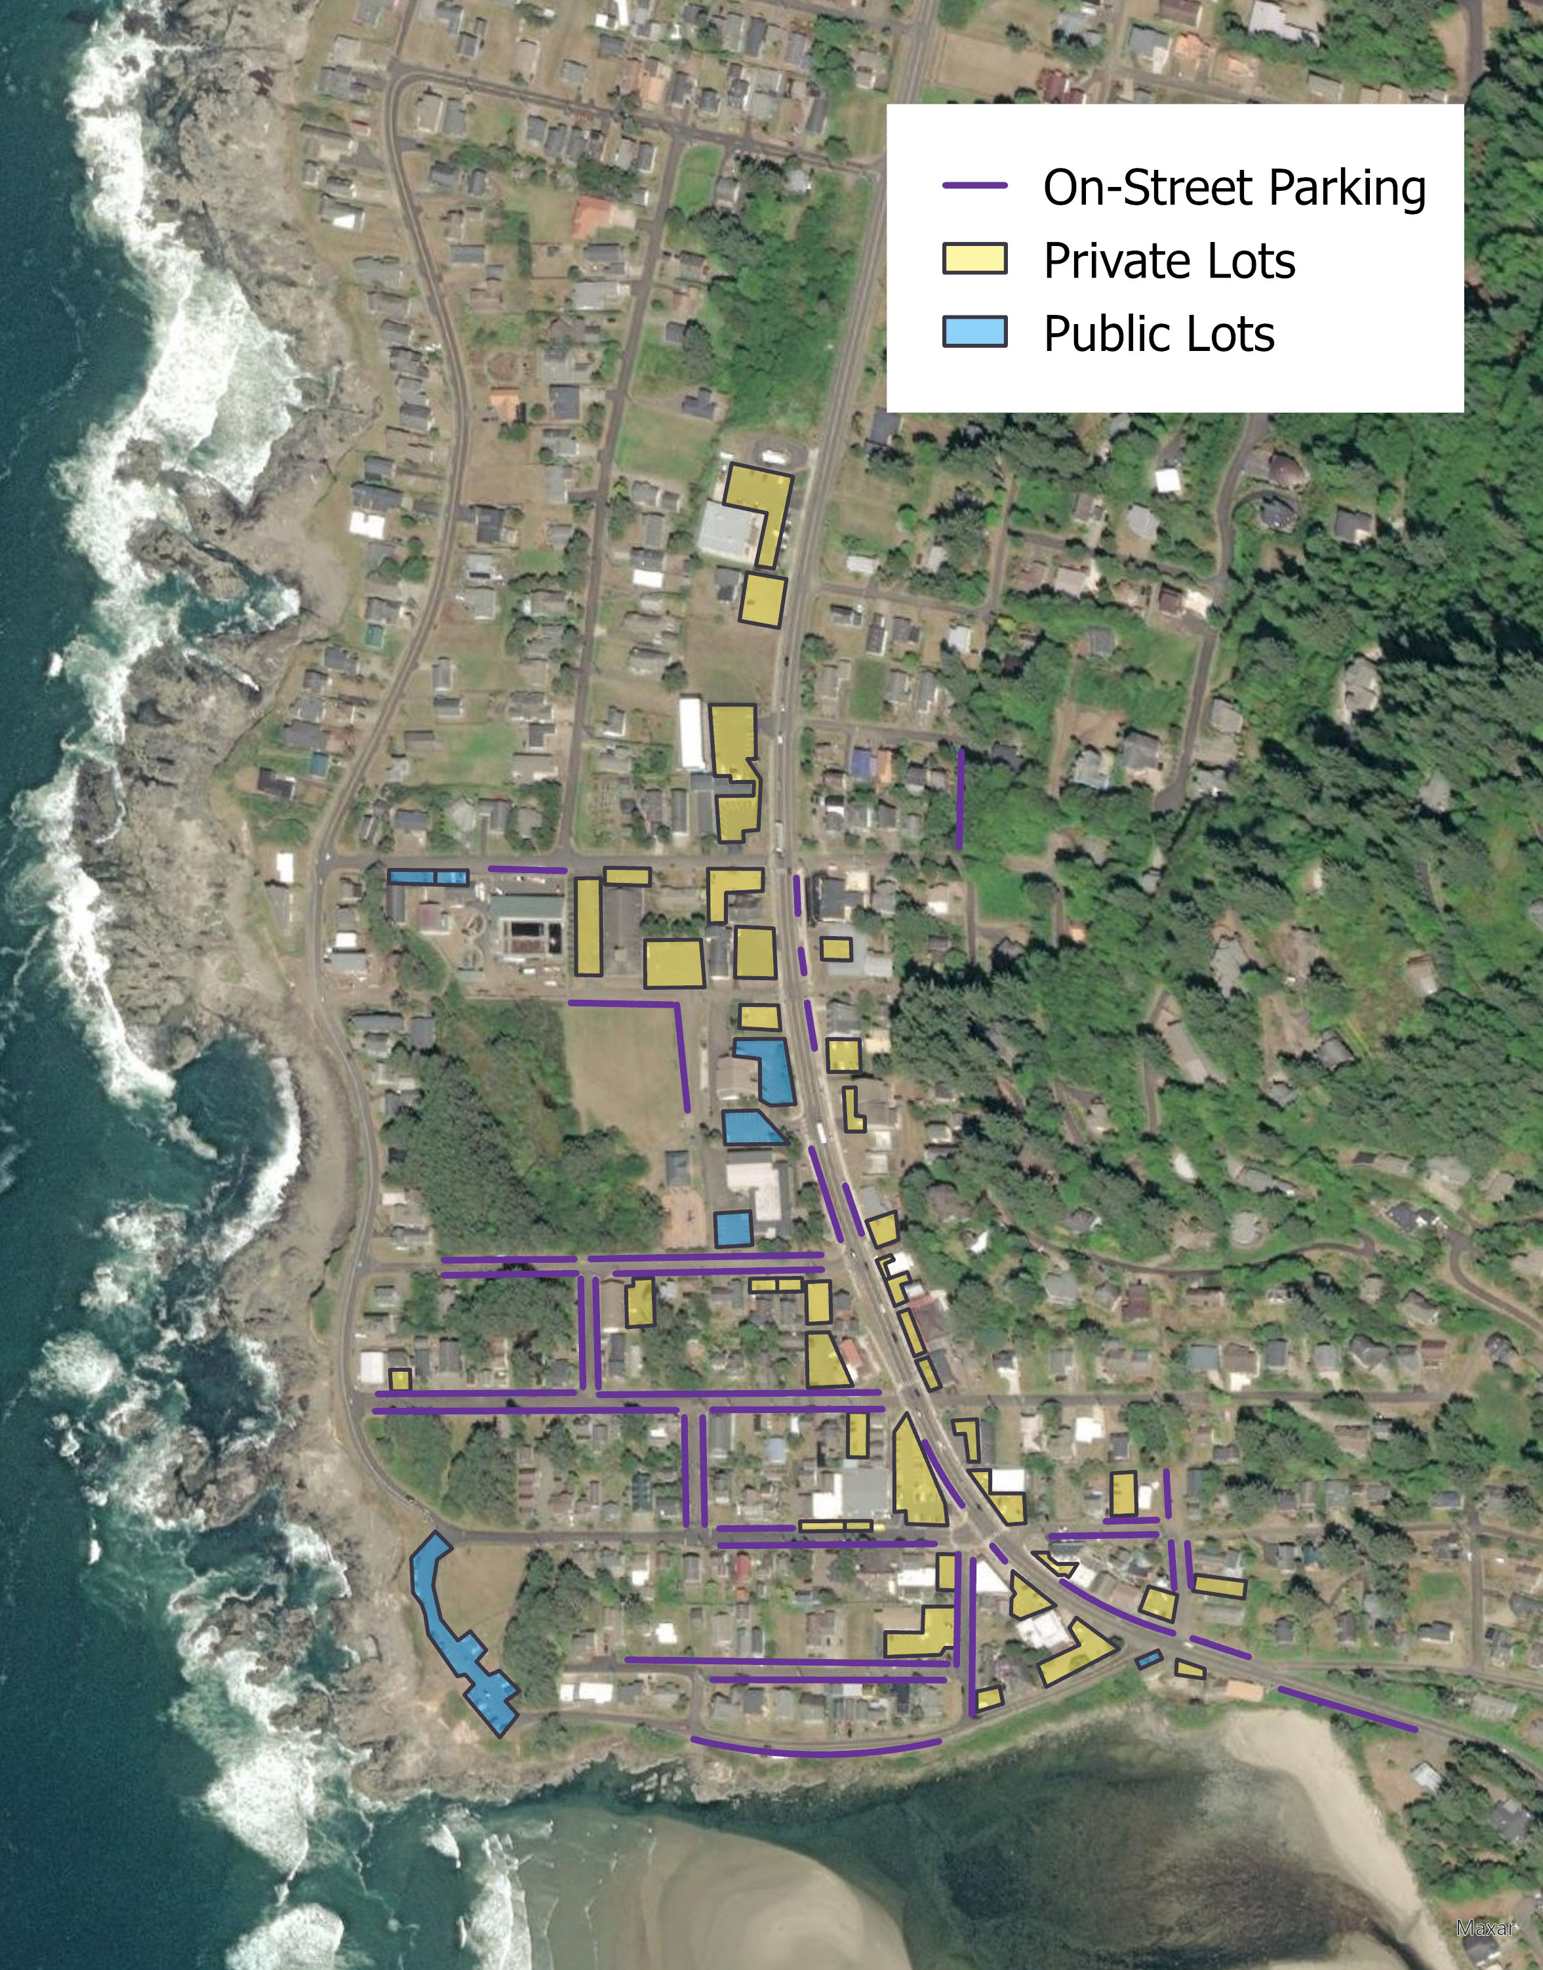
Parking Facilities
Around 900 parking spaces in total with study area
Many on-street stalls and several lots are un-striped, so precise stall count is infeasible
Key public lots at Yachats State Park (State), Commons building, City Hall

Slide 14
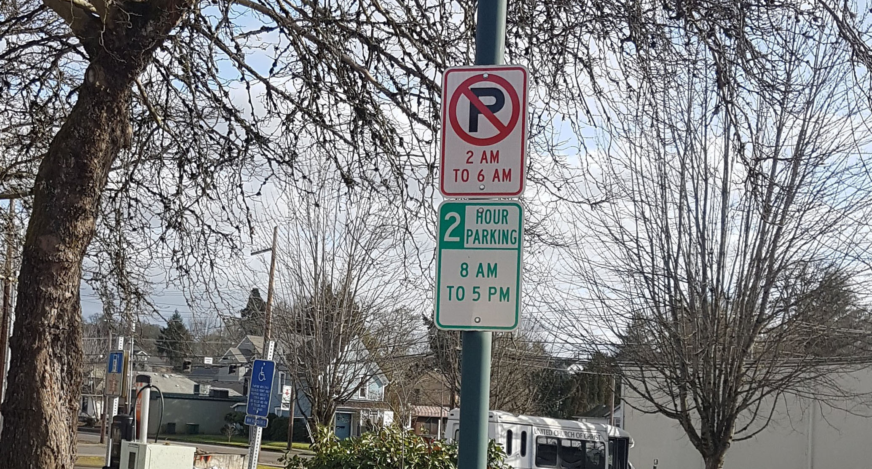
Parking Management in a Nutshell

Slide 15
Parking Management Goals
Create “right-sized” parking solutions
  Too little parking: Traffic congestion from cruising, potential safety impacts, potential lost business & economic impacts
  Too much parking: Walkability and sense of place impacted, public money wasted
Create regulations and policies consistent with goals for growth, economic development, livability
  These are addressed within comp plan and other planning guidance
Ideal: 1-2 spaces free within a block or so of any potential destination

Slide 16
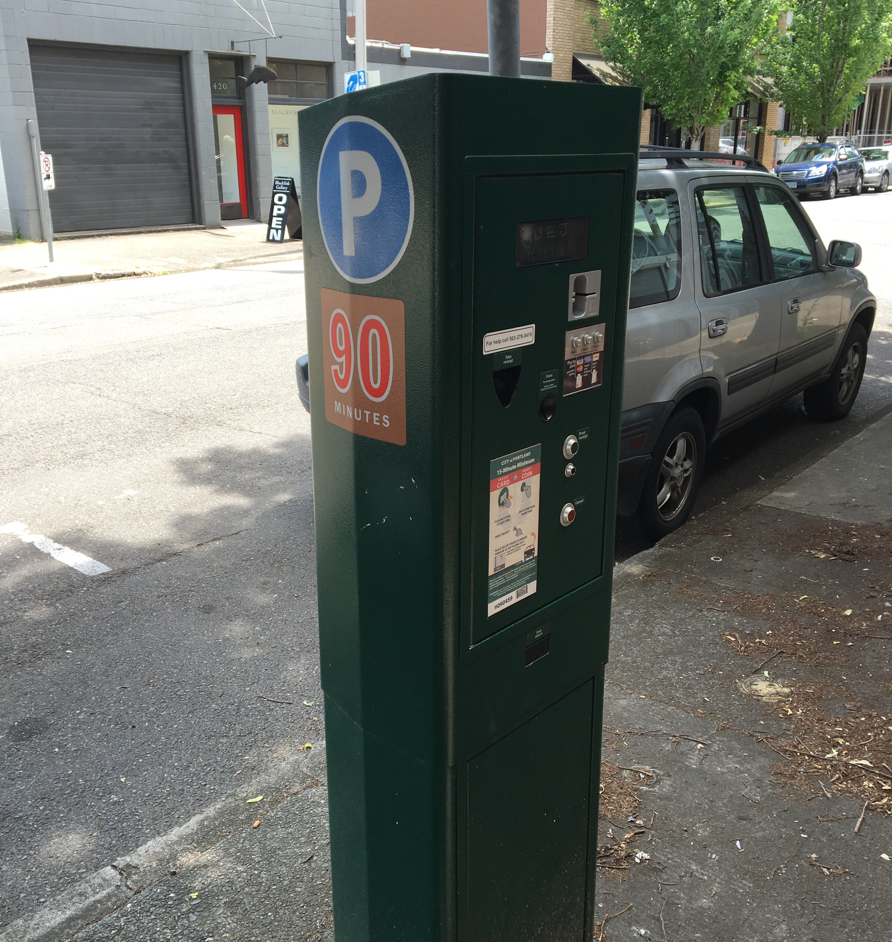
Metering / Priced Parking
Powerful and effective tool to manage demand while also creating a source of revenue
BUT invariably politically contentious
  Within coastal towns, feeling of friendly competition between cities; if parking is priced in one community tourists will drive to the next one
Newport, OR Bayfront is only coastal community to wit employing (approved 2020, coming soon…)

Slide 17
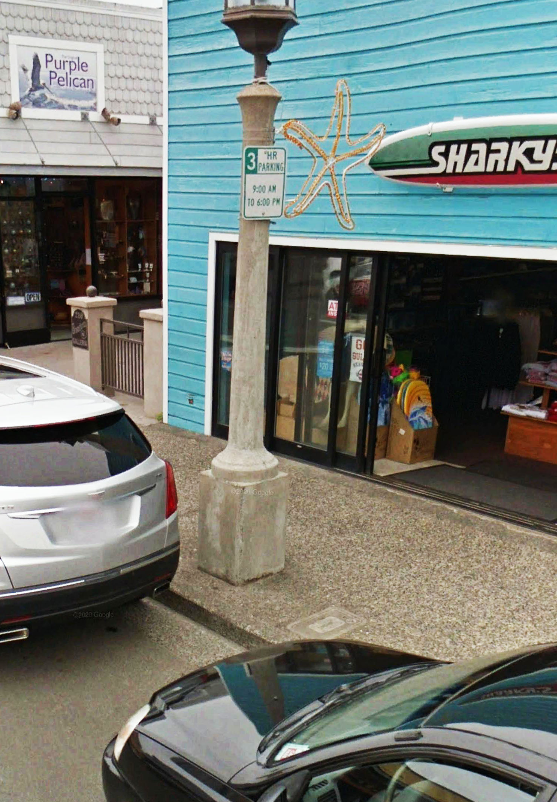
Time Limits / Time Prohibitions
Time limits require all stays within a parking facility to be under a certain period of time
  2 hours is common in retail/restaurant settings
  4 hours is common where longer stays expected but want employees to park elsewhere
Time-of-day prohibitions preclude parking at certain times, or activate time limits during daytime/busy periods

Slide 18

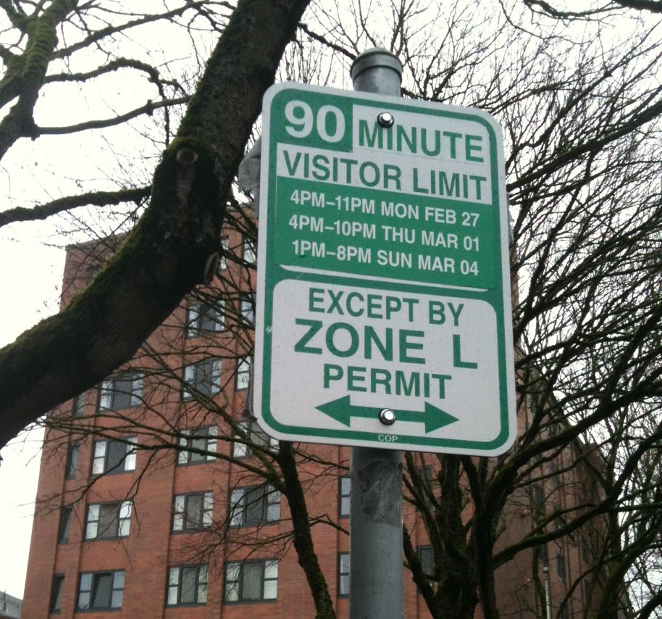
Permit Programs
Aim to encourage certain types of parking demand within certain facilities
  Common examples include residential or employee parking
Other demand can be precluded entirely, time limited, or even paid
Many, many ways to structure permit programs to meet certain goals. Can get creative!

Slide 19
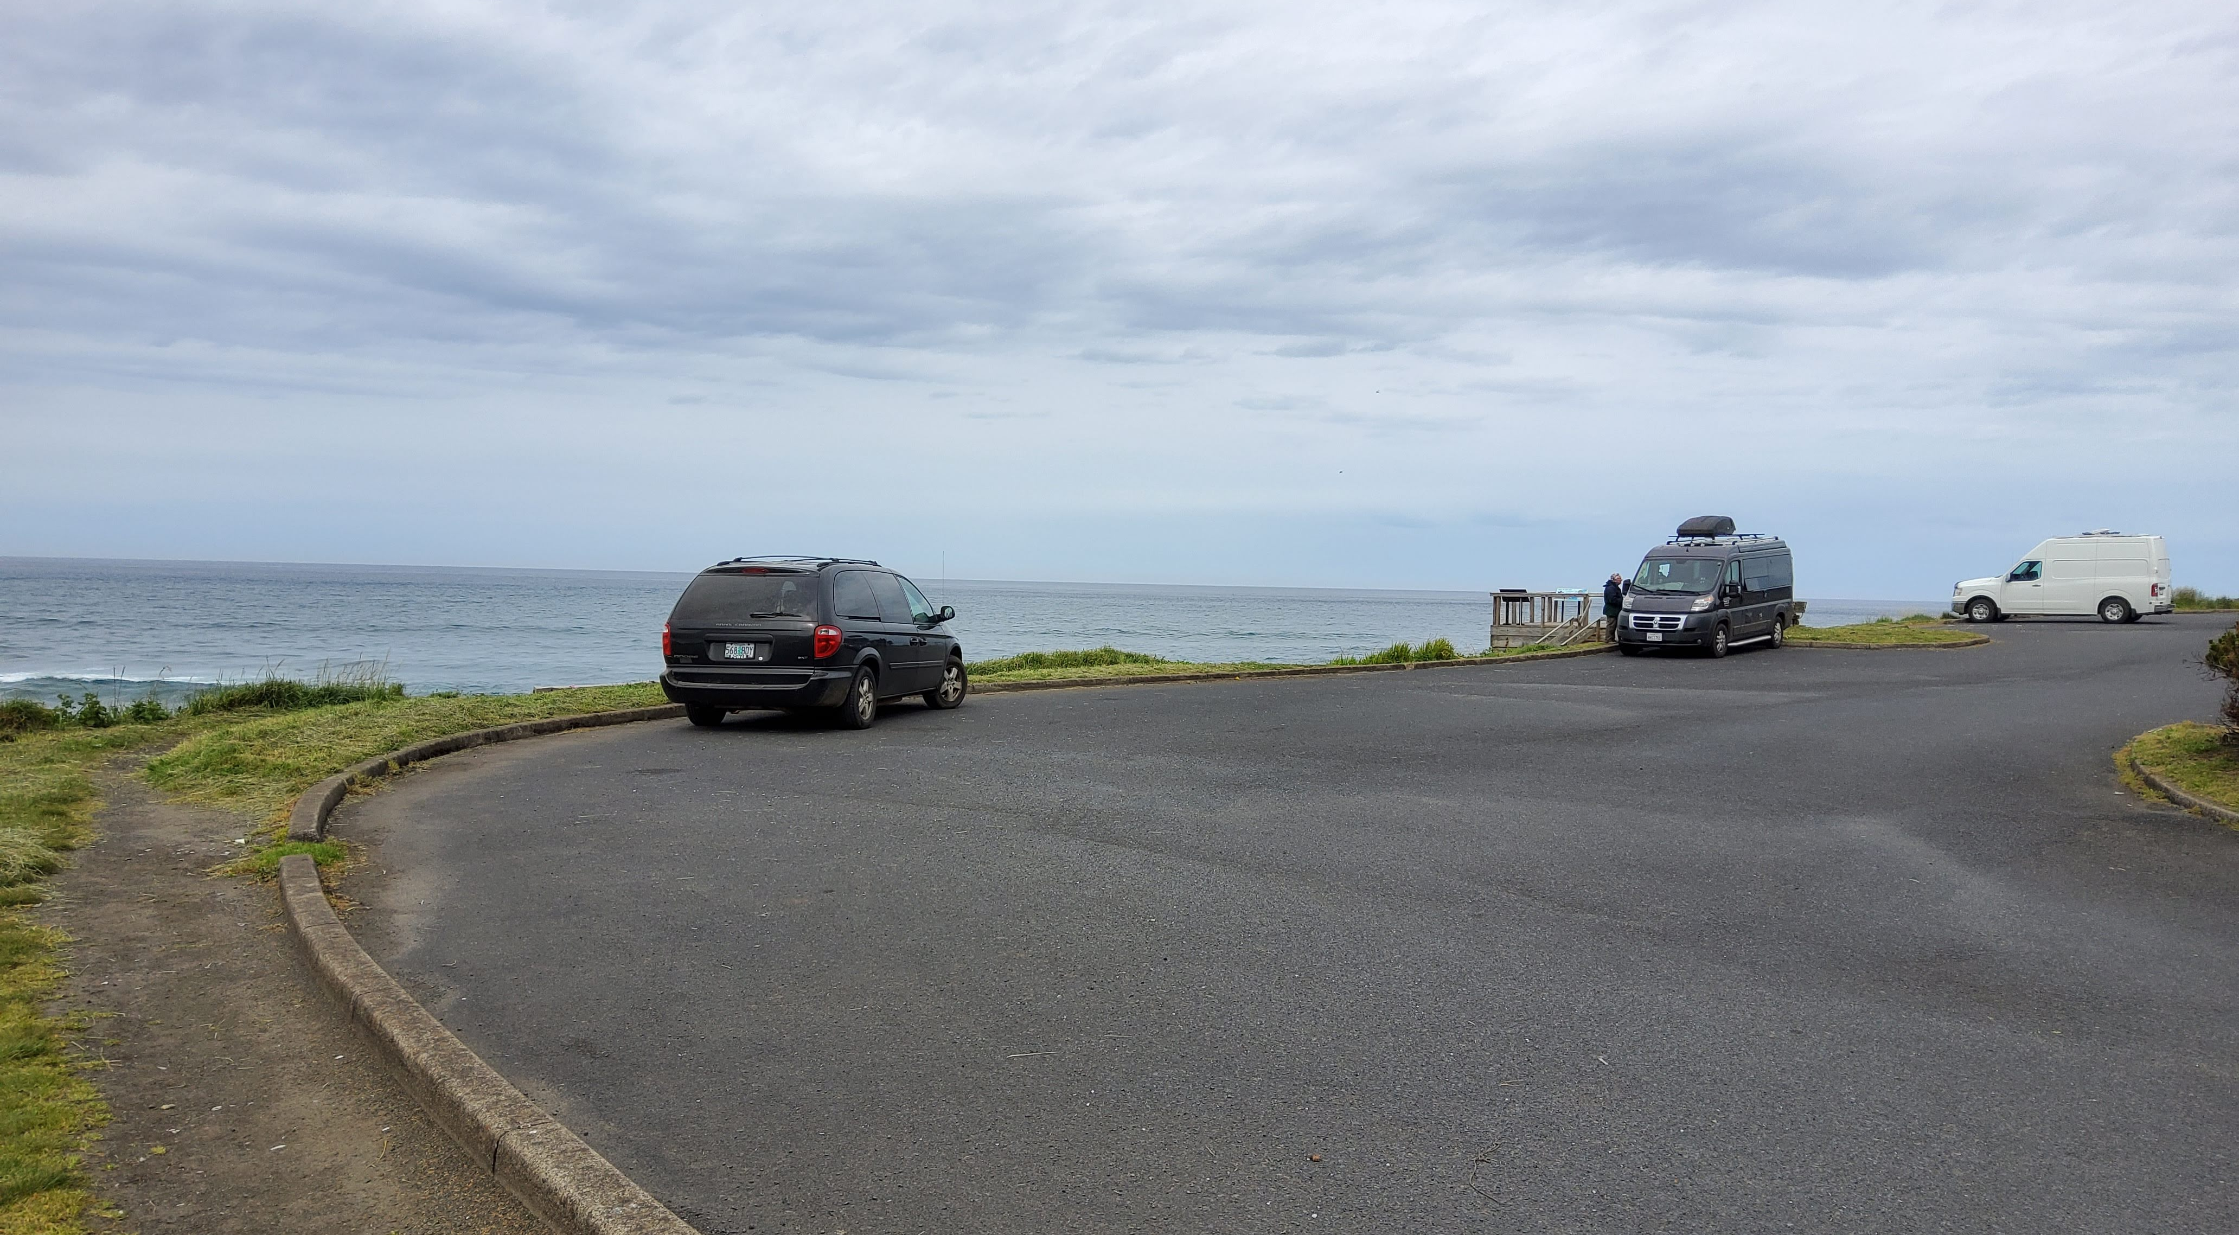
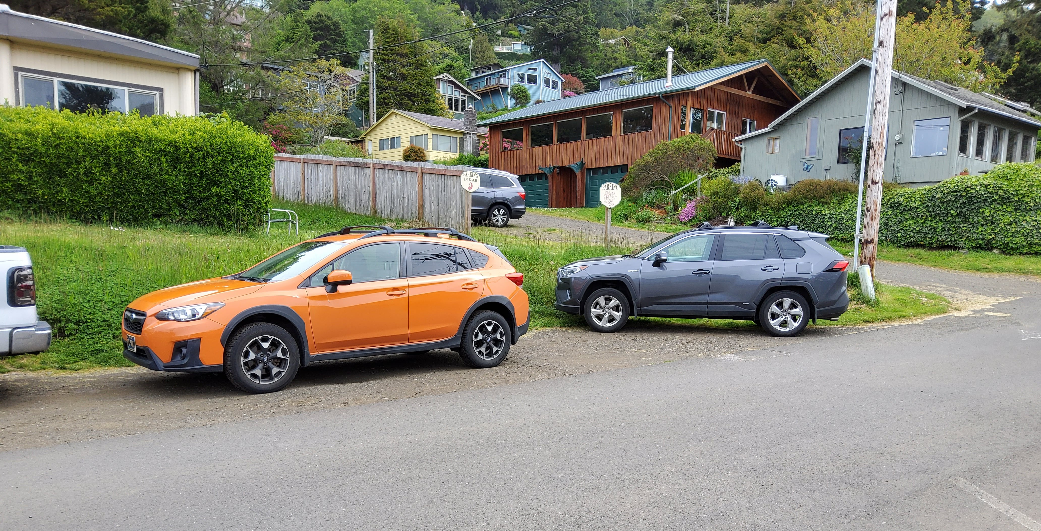
Striping
Striping stalls can often improve efficiency within lots or on-street parking by providing guidance and affirmation
Relatively uncontentious and inexpensive but does require regular maintenance/refreshing
Sometimes residents oppose striping adjacent to their properties as it’s seen to encourage parking

Slide 20
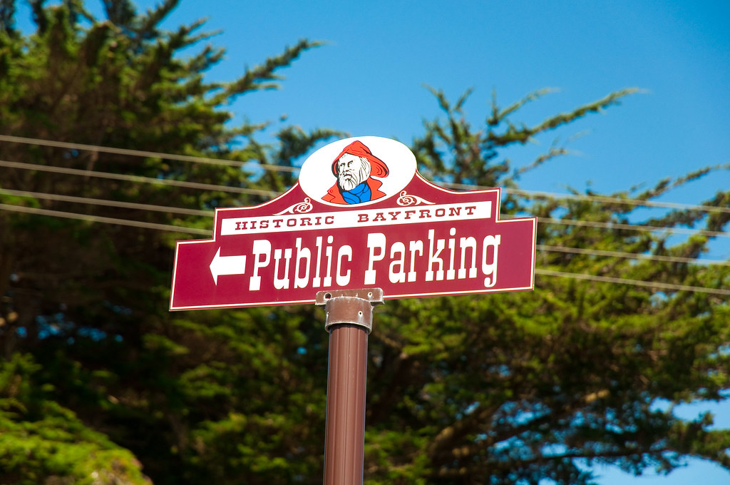
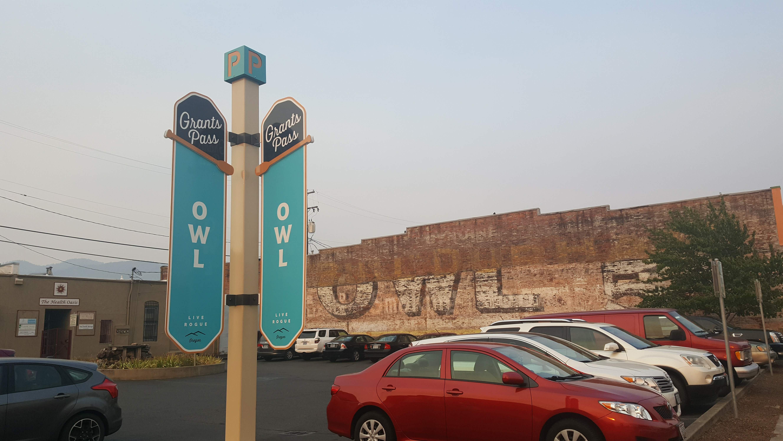
Branding / Wayfinding
Wayfinding aims to help people easily find parking when arriving by car, and navigate to and from their parking space while on foot
  Important to consider from both driving and walking perspectives
Branding helps people identify public lots, provides guidance and affirmation
Ideally integrated with websites, visitor center, tourism info

Slide 21
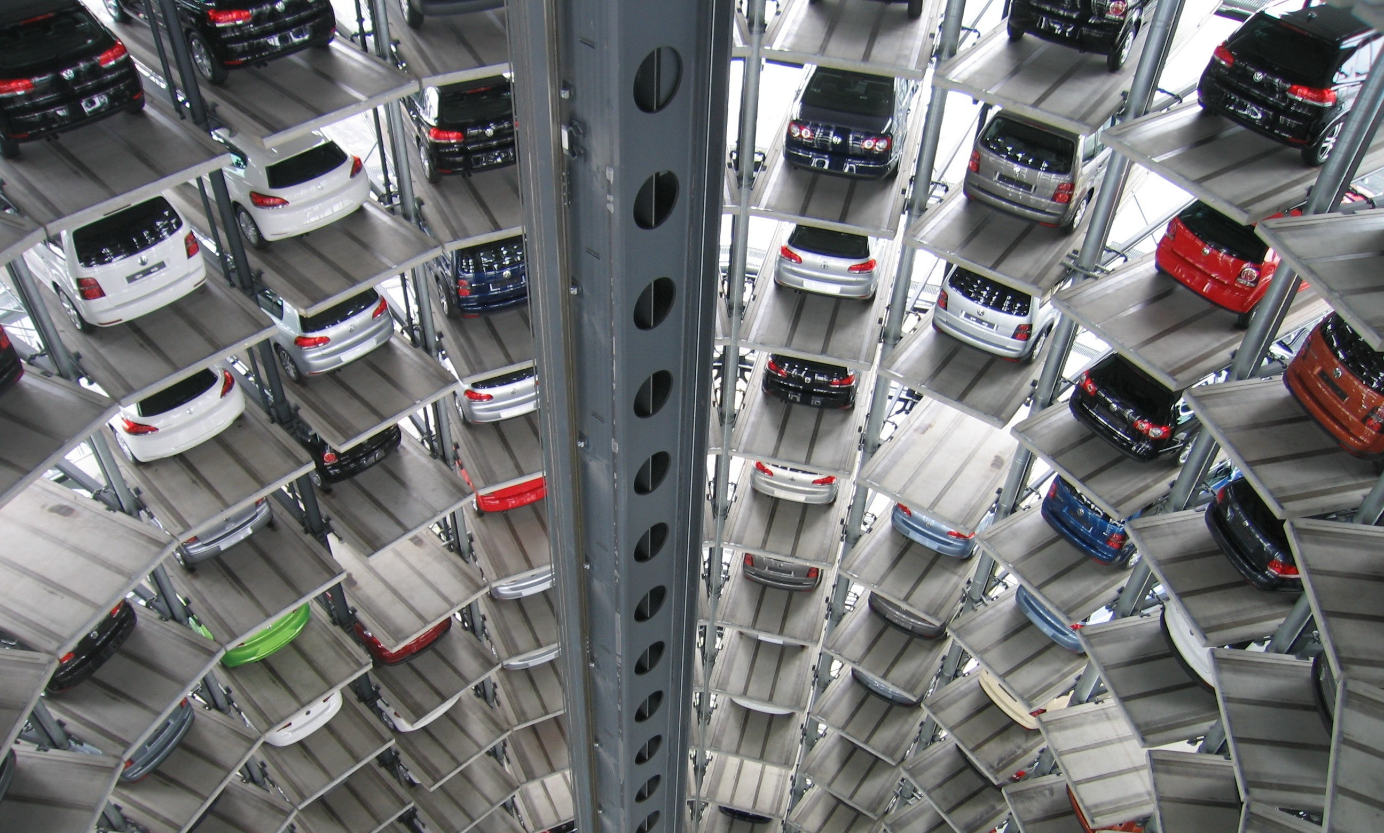
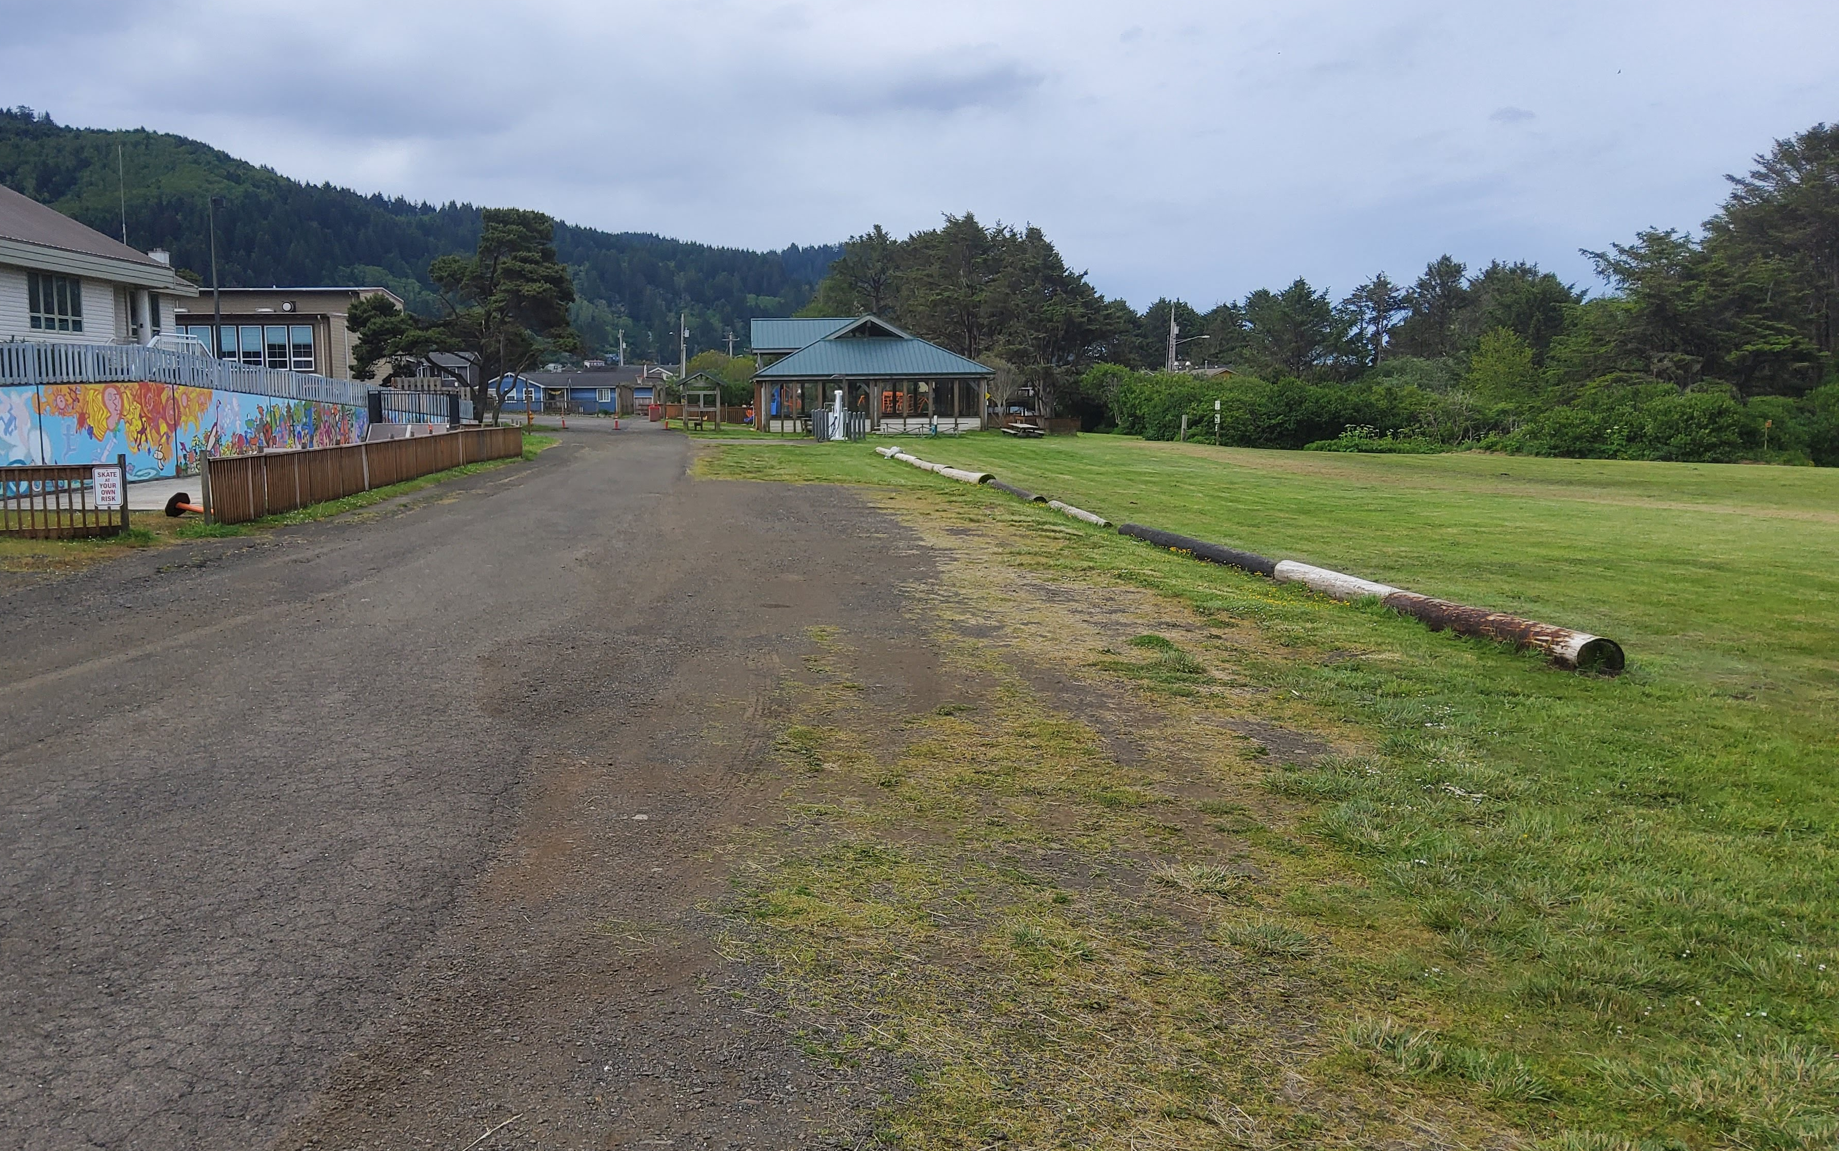
Additional Parking Supply
Like enforcement, tends to be relatively politically popular. Upside is obvious in satisfying additional demand. Perhaps induces new demand.
Downsides: Expense, location (best sites are already developed or used for parking!), walkability and livability concerns

Slide 22

Enforcement
Enforcement of time limits, regulations, “customer parking only,” etc.
Difficult to accomplish effectively in many settings; often significant expense associated
In tourist settings, concerns of leaving visitors with negative impression

Slide 23
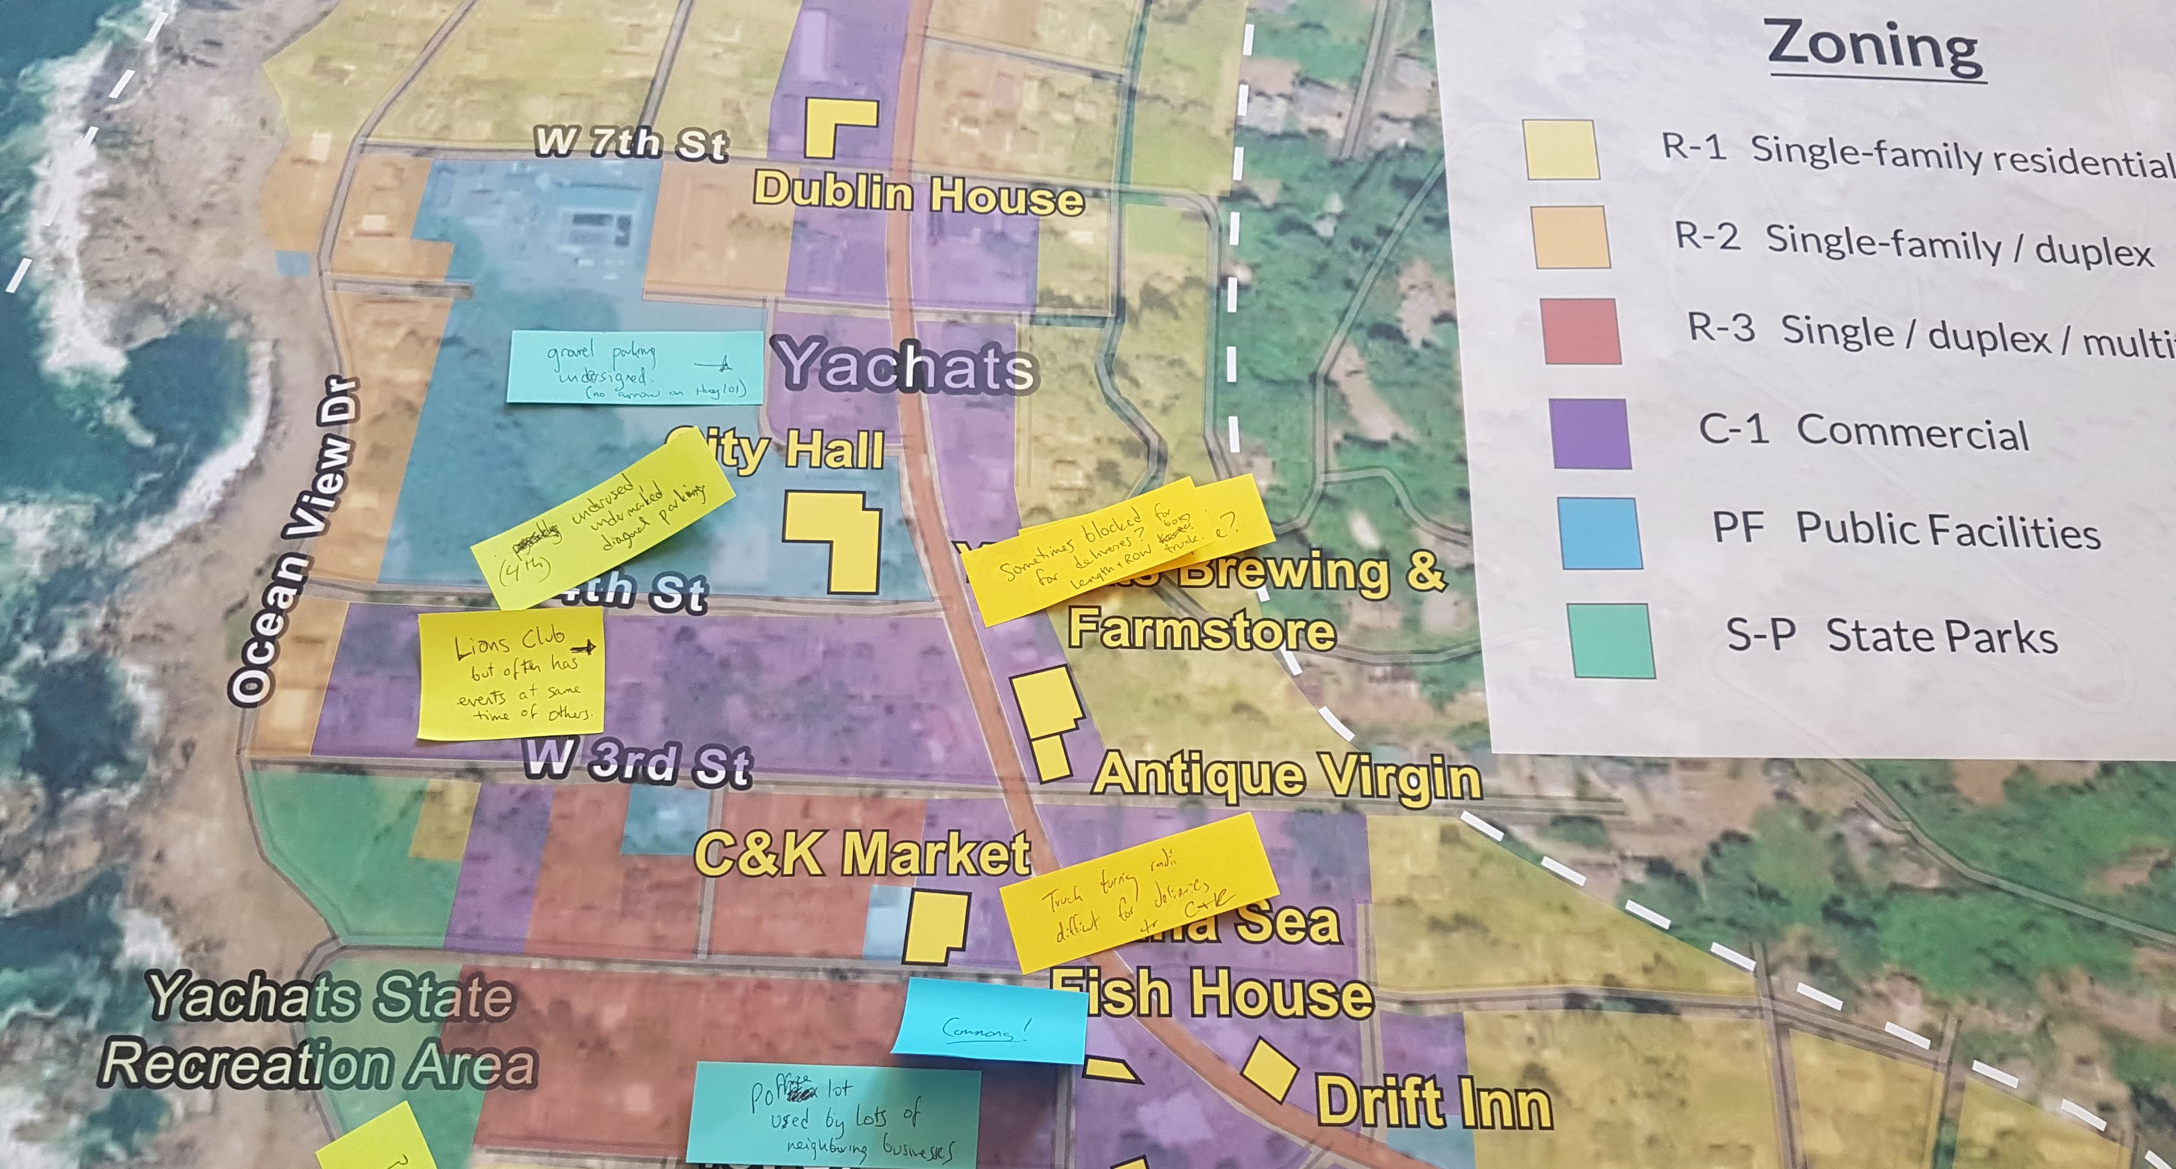
Problems Identified (So Far…)

Slide 24
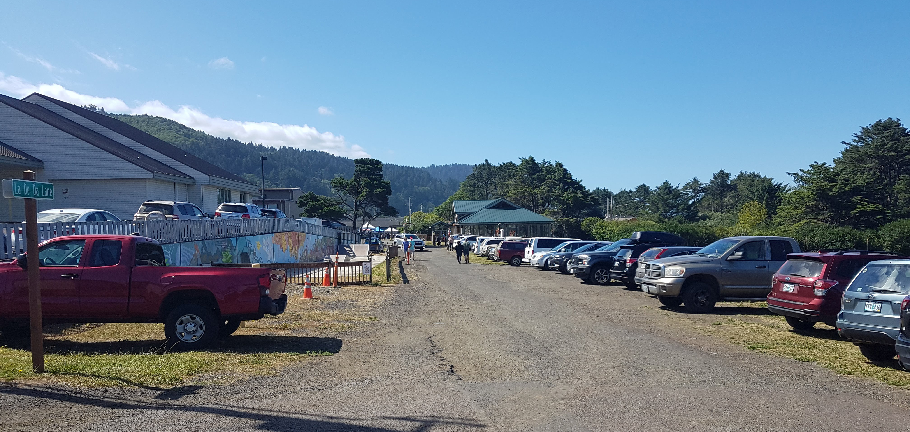
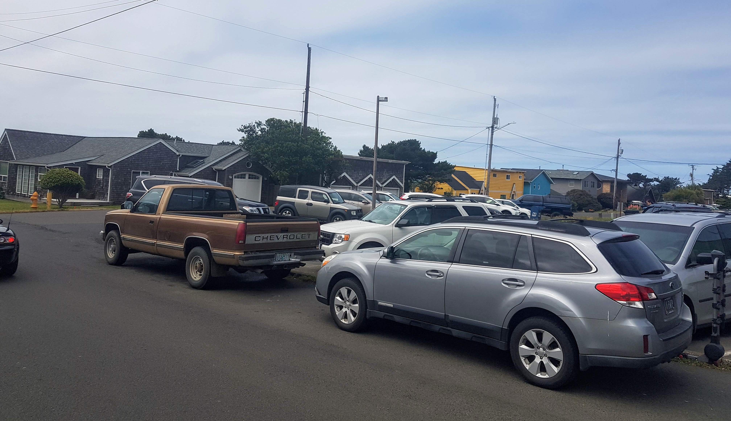
Peak Season & Event Parking
General feeling of supply > demand during events, summer weekends
Limited opportunities for circulation create traffic issues as people search for parking

Slide 25
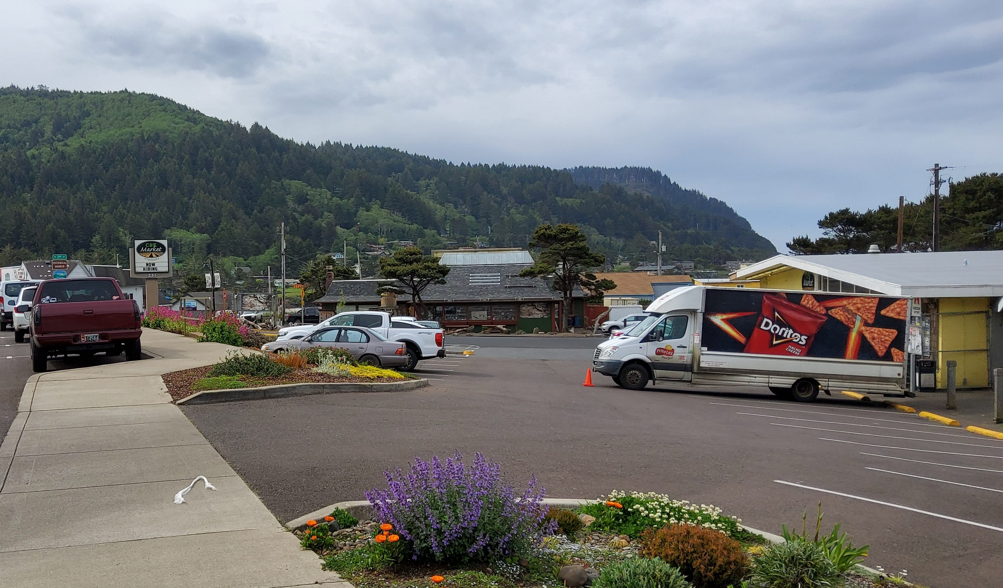
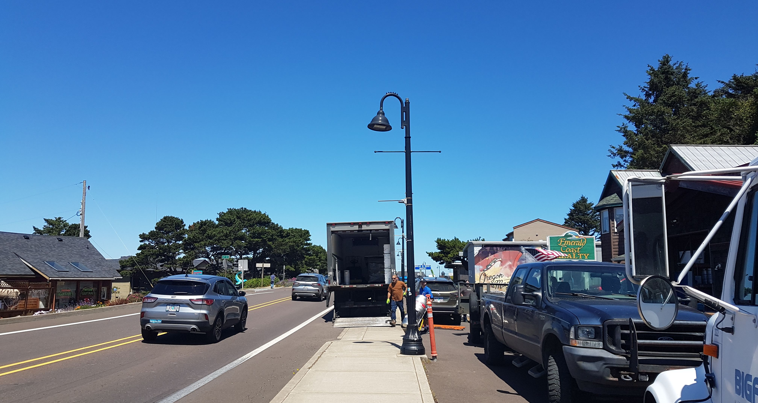
Lack of Dedicated Loading Space
Several businesses have reported that trucks are forced to stop in traffic lanes and/or block sidewalks for deliveries
Problematic along 101 especially since redesign, Ocean View Drive, within some lots constrained by 101 improvements (ex. C&K Market)

Slide 26
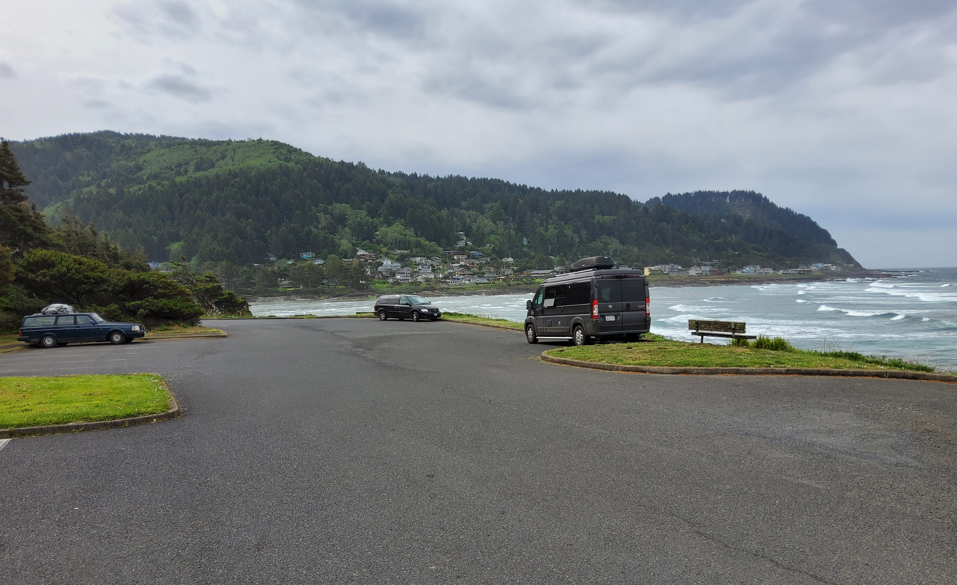
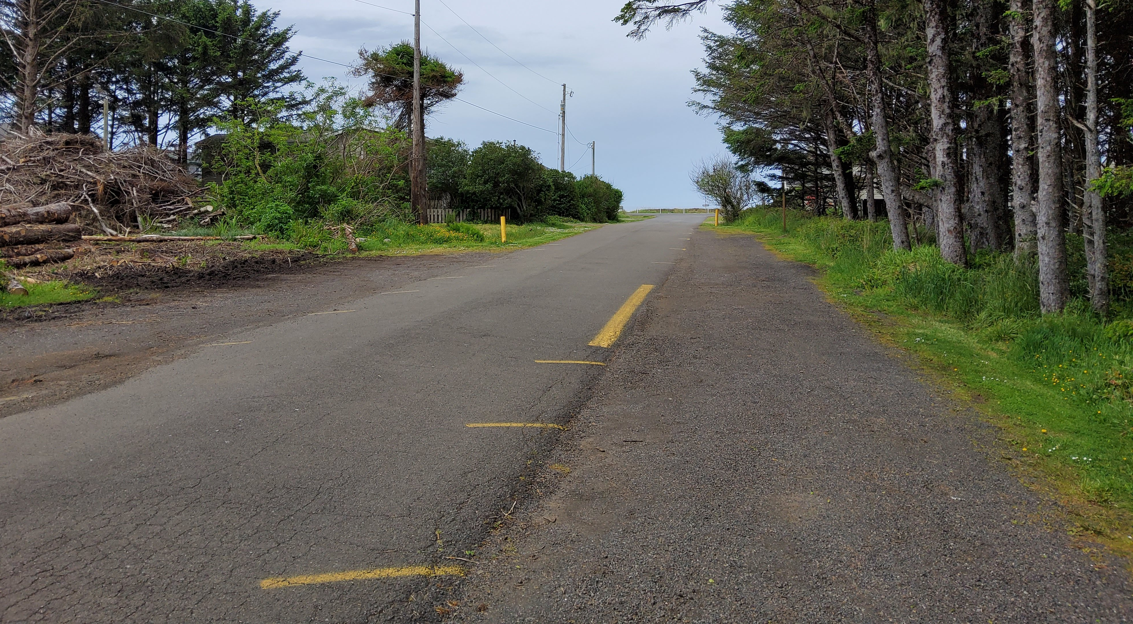
Faded/Incomplete Striping, Paving
The public lot at Yachats State Park (and many private lots) are used inefficiently as stripes have worn
Highway 101 now has mostly striped parking but still missing in unimproved areas and local streets
Other striping (ex 4th) is confusing or incomplete

Slide 27
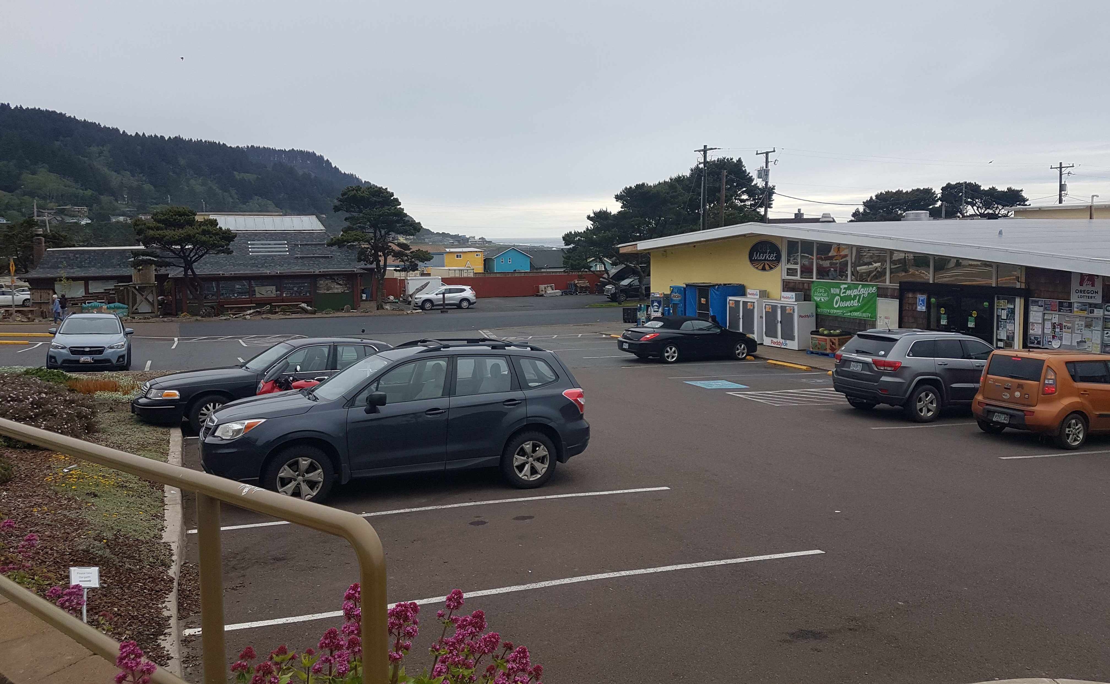
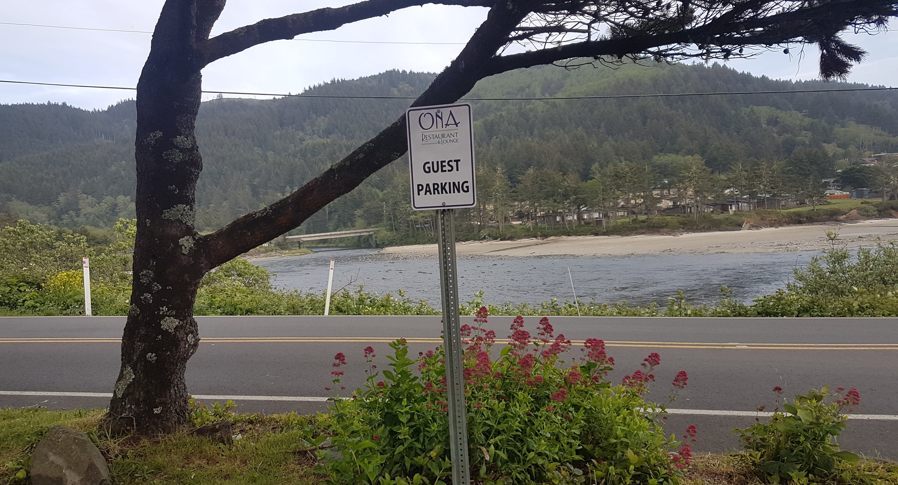
Private Lots Used Publicly
Privately owned parking lots are often used as de facto public parking, particularly during busy times
C&K Market, Post Office
Businesses have tried interventions such as signs, but there’s a clear need to address broadly

Slide 28
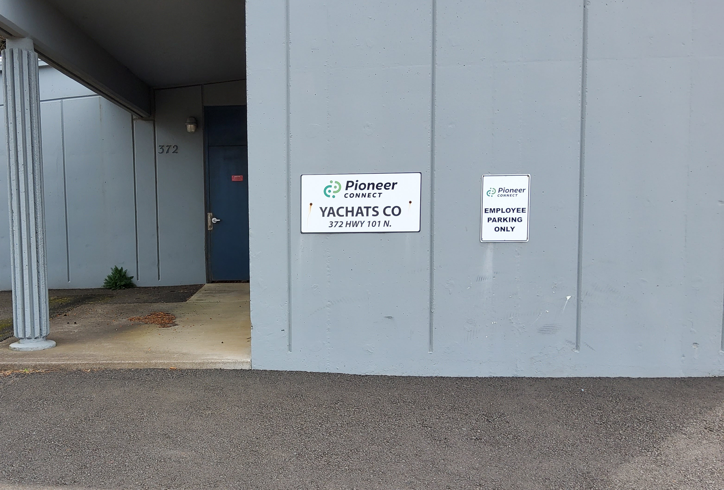
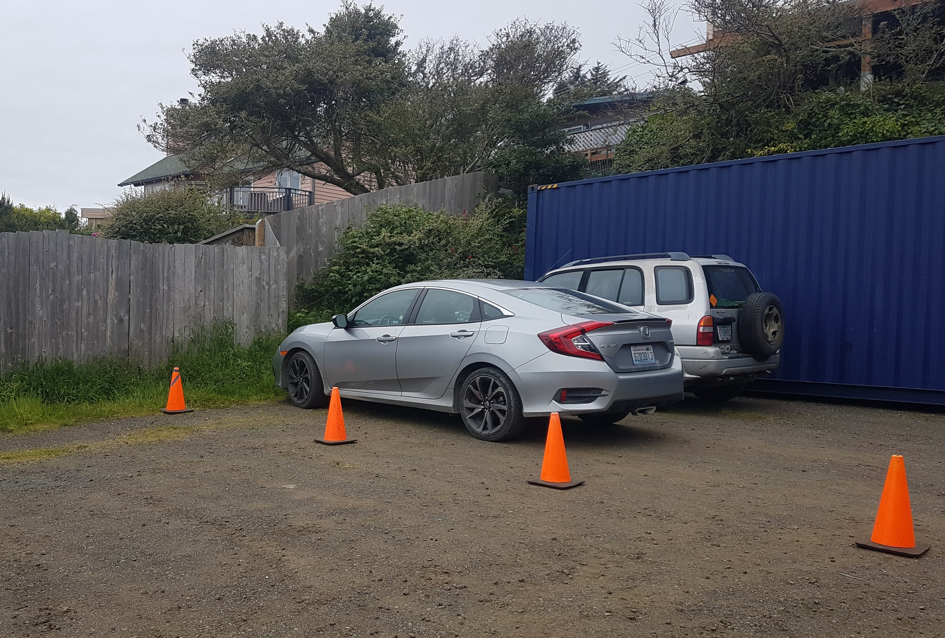
Employee Parking
Employees often get “first choice” of parking since they arrive before patrons, thus taking the “best” spaces
No obvious dedicated facilities for employees. As with previous issue, businesses have implemented measures individually but there is a need to address broadly

Slide 29
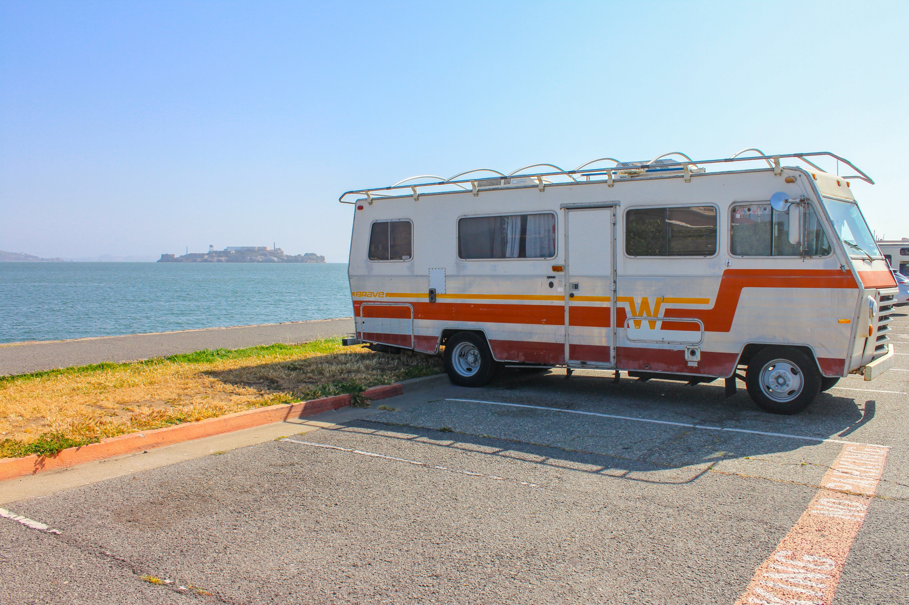
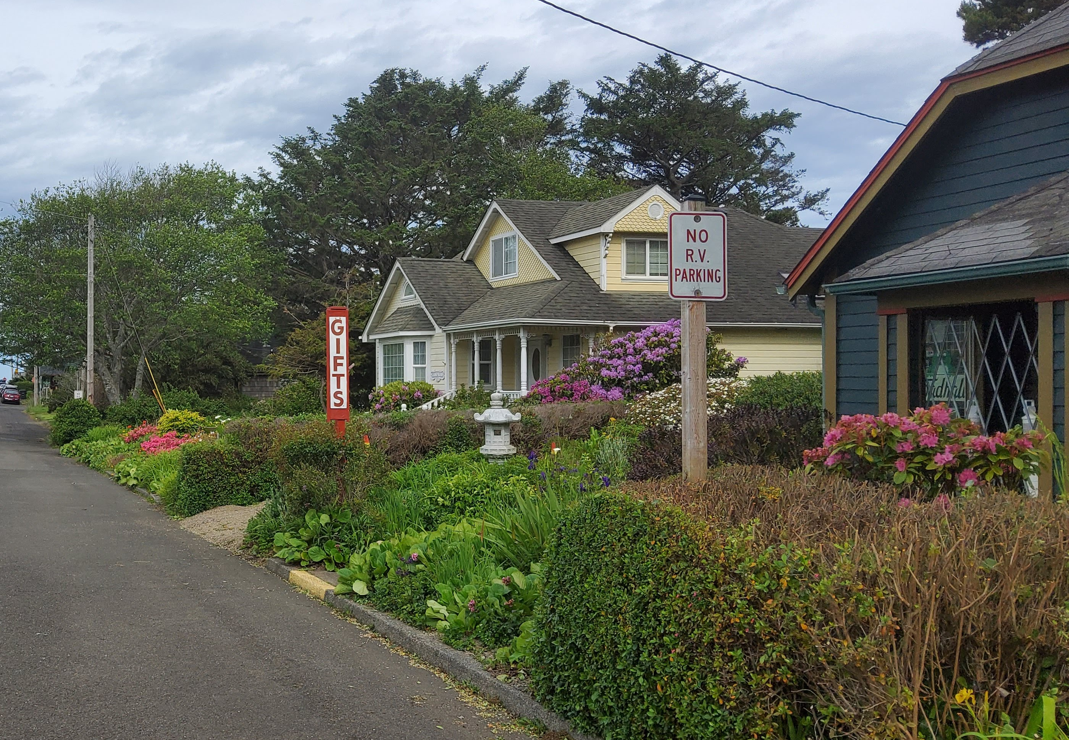
RV Parking
Like many coastal communities, many RVs travel to and through Yachats.
With no signed, dedicated spaces or guidance, RVs can cause congestion and safety issues as they look for parking
Should the City dedicate space for RVs? Where? State Park? La De Da?

Slide 30
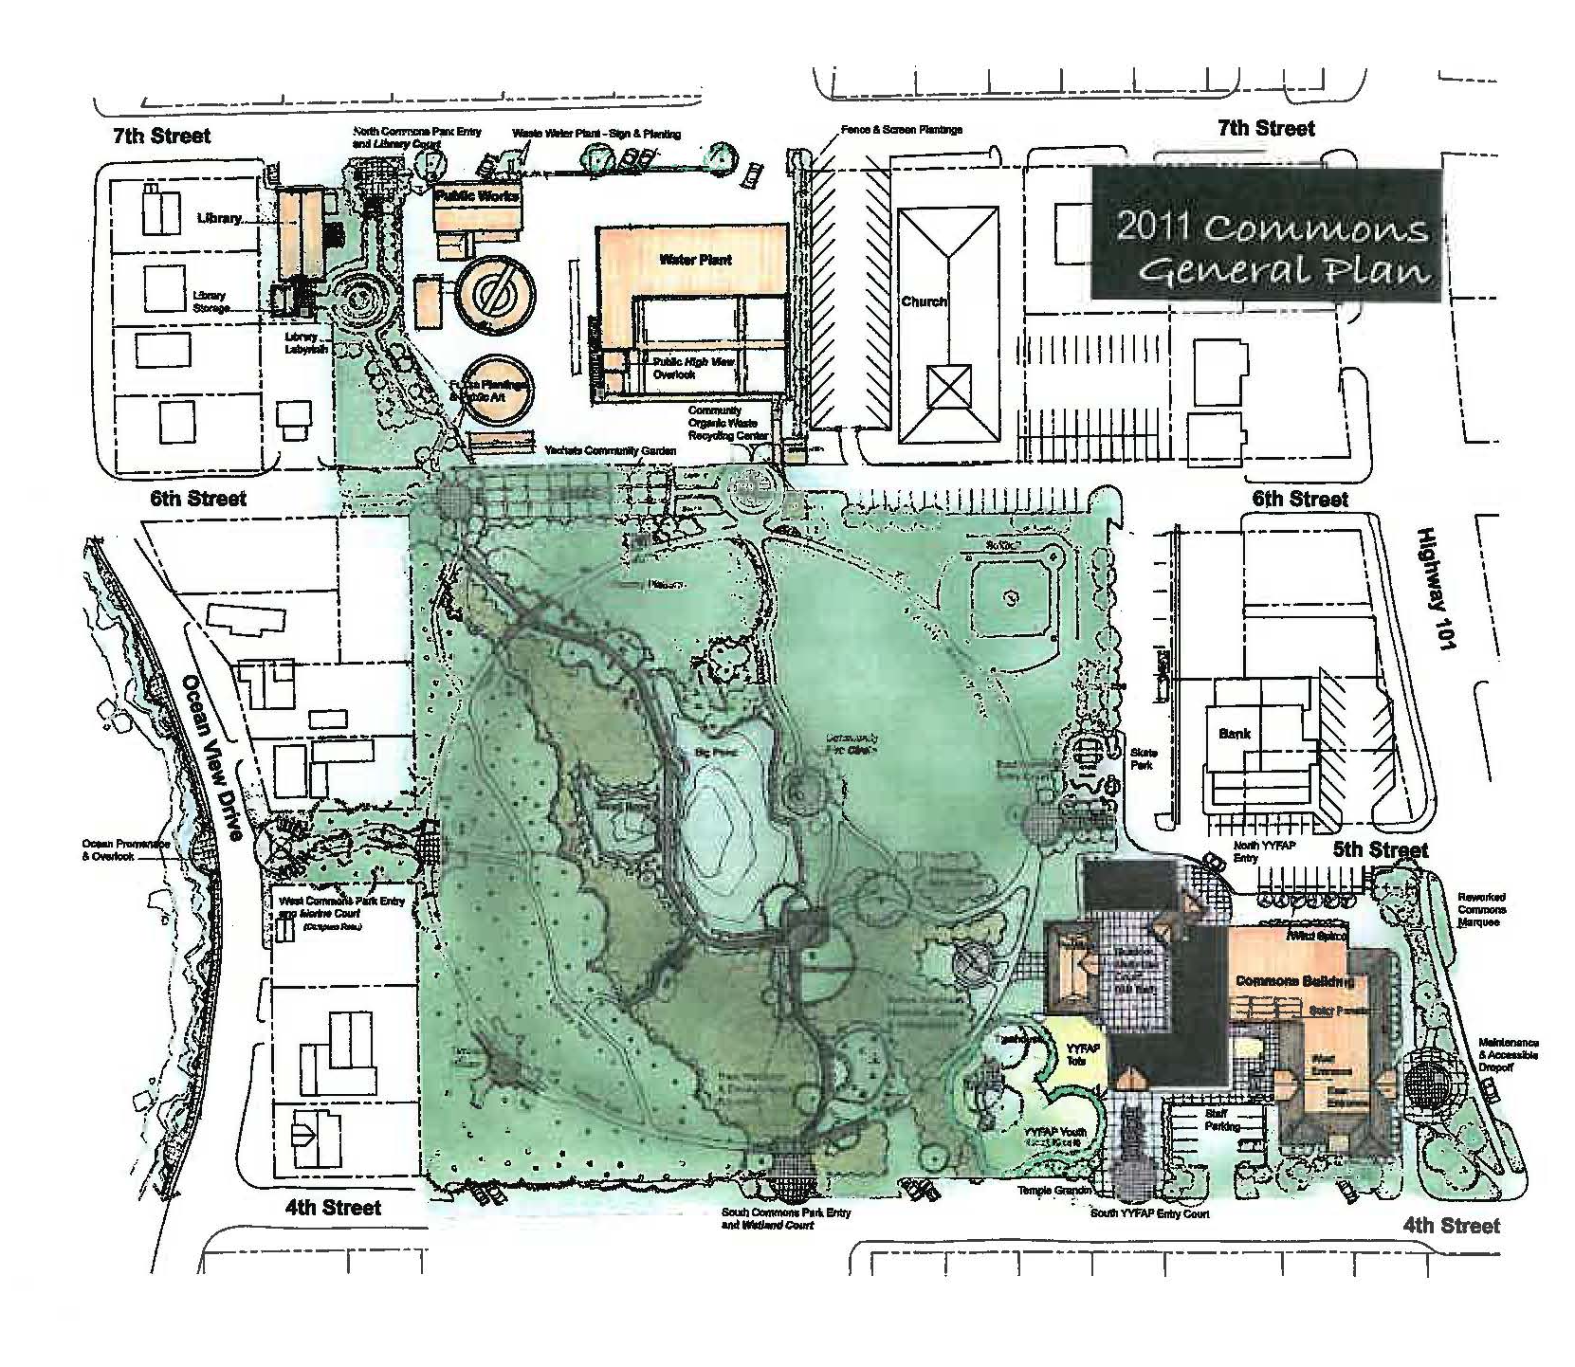
La Di Da Lane & Commons Frontage
One of few areas within downtown Yachats where additional parking installation is feasible
Various visions through the years. La De Da is currently important to RV’s, e-vehicles
  Keep as RV’s and formalize? Stripe for cars?

Slide 31
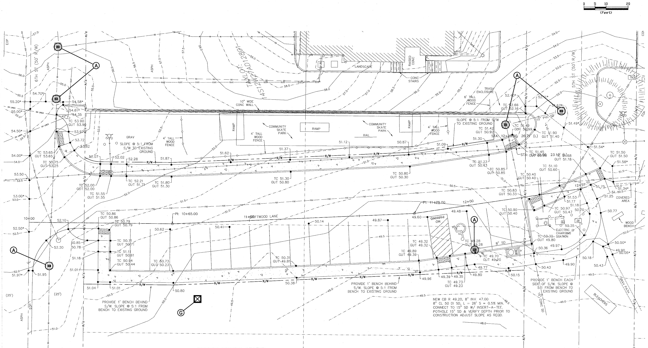
La De Da Proposed Striping
Previously proposed but grant has expired. No current plans to build but maybe opportunity to revisit, find funding?

Slide 32
Feedback and Input Opportunities
Did we miss any problems that you encounter regularly?
Any other feedback or thoughts?
Ways to provide feedback:
  Q & A to follow (comments will be recorded)
  Questionnaires
  Maps
  Email me! brian@studiodavispdx.com

Slide 33

Questions?

